Slide 1
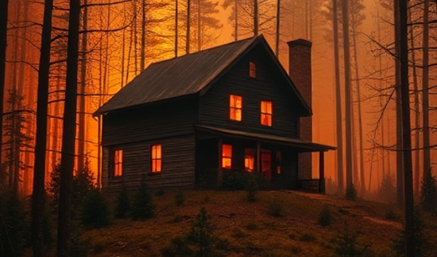









HMM-N Home
HMM-N ☑
HOME PAGE
HOW TO USE THIS WEBSITE/TOOL
This website is designed as an education tool to allow homeowners to work together to enhance the ignition resistance of their neighborhoods. As you will learn when the Hazard Mitigation Methodology (HMM) is outlined, it is critical for residents to work together to address the fire problem collectively, across parcel boundaries. This is essential as fire does not care or respect property boundaries.
This web-based tool is intended for residents and homeowners. However, decision-makers can also use this information to prepare their community against fire. There are six distinct modules. It will take a total of approximately four hours to go through all the modules. While this is a significant time investment, you do not have to go though all the models in one go.
In Module 1, you will learn:
How fire spreads in the Wildland Urban Interface (WUI)
Why WUI fires are different from other disasters and what this means for preparing your community
Why homes ignite
Limitations of Codes and Standards
Module 2 and Module 3 offer a new way to help you think about house survivability, and also introduce the Hazard Mitigation Methodology (HMM). HMM is a comprehensive approach to community, parcel and structure hardening that is exposure-based, not parcel-based. HMM is fundamentally different from most other mitigation approaches.
Module 4 contains instructions on how to use the NIST Virtual Wildland Urban Interface (WUI) Community in Module 5. This will take about xx minutes to go though.
Module 5 Contains the interactive NIST Virtual WUI Community (Module 4). In this module you will learn about HMM and see how it can apply to your neighborhood, parcel and home.
Module 6 describes the steps you and your neighbors need to follow to implement HMM. This will take about xx minutes to go though.
Module 7 has the tools, in the form of checklists and other materials to help you and your neighbors work together to implement HMM in your neighborhood. A glossary is also included here to help with definitions of terms commonly used in the Wildland Urban Interface (WUI ) and HMM.
WEBPAGE 1ofX
HOMEPAGE/
LANDING PAGE
1.0 WUI FIRES
1.1 What is a WUI fire?
1.0 WUI FIRES
1.2 How WUI fires spread
1.2.1 What are fire and embers exposures?
1.2.2 What is hardening?
1.3 Why homes catch on fire?
1.3.1 Fire spread pathways within and across parcels
2.0 RETHINKING HOUSE SURVIVABILITY
1.3.2 Codes, Regulatory and Best Practices Gaps (or… “Gaps in Codes, Regulatory and Best Practices”?)
2.0 RE-THINKING HOUSE SURVIVABILITY
2.1 Breaking Fire-Spread Pathways
2.1.1 Breaking Flame-Spread Pathways
2.1.2 Breaking Ember-Spread Pathways
3.0 WHAT IS HMM AND WHY IS IT DIFFERENT FROM OTHER FIRE HAZARD MITIGATION APPROACHES?
3.0 WHAT IS HMM, HOW IT’S DIFFERENT
3.1 Understanding the evacuation timeline
3.2 Determining the two evacuation scenarios
3.3 A coupled fire-evacuation system
3.4 Determining decision points
3.5 Relationship between ignition location and impact to community
3.6 The evacuation triangle
4.0 HOW TO USE THE VIRTUAL COMMUNITY
4.0 HOW TO USE THE HMM NIST WUI VIRTUAL COMMUNITY
4.1 Pick your neighborhood type
4.2 Learn about fire hazards and solutions in your neighborhood type
5.0 THE NIST
WUI VIRTUAL COMMUNITY
4.3 Example of fire hazards and solutions for a house in the neighborhood
5.0 THE NIST WUI VIRTUAL COMMUNITY
6.0 How to Implement HMM in your Neighborhood / or / Tools to Implement HMM in your Neighborhood
6.1 How to get started and what you will need
6.2.1 HMM Fact Sheet
6.2.2 HMM Implementation Workflow
6.0 IMPLEMENT HMM
6.2.3 HMM Parcels Checklist
6.2.4 HMM Structure Ember Hardening Checklist
6.2.5 HMM Implementation Drawings – For Contractors
6.2 HMM Implementation Fact Sheet, Checklists, and Drawings
6.3 HMM Implementation Limitations
6.4 HMM Implementation Costs
6.5 The Critical Importance of HMM Maintenance
7.0 HMM Resources
7.1 WUI and HMM Glossary
7.0 HMM RESOURCES
7.2 HMM for AHJs Web-based Tool
7.3 HMM report and Presentations
7.4 Community Application for Federal Funding
7.5 HMM Cost Estimates
7.6 HMM Implementation Q & A
7.7 Serious Game
7.8 Contacts Info
Cautions, Disclaimers, and Limitations
This web-based tool is designed to inform and educate residents and homeowners on how to prepare their homes/parcels and community against WUI fires.
The proposed approach, the Hazard Mitigation Methodology (HMM), works by fully protecting a home against exposures from flames and embers.
There are limitations to home hardening effectiveness. These limitations will impact where HMM will work and where it will not.
HMM points to a number of ember vulnerabilities that are typically found on homes. Some homes may have fewer, while others may have even more than those listed in HMM. All home vulnerabilities to ignitions from embers need to be addressed, even if they are not explicitly listed in HMM.
Where HMM is implemented, it can only work if all the ember hardening is done AND all flame exposures are managed either by removal/reduction or under certain conditions by structure hardening.
NIST is not a regulatory agency and in that capacity cannot enforce or regulate the use/implementation of HMM.
NIST makes no claims to the effectiveness of HMM as local conditions can vary greatly even with very small changes in the fuels.

Slide 2
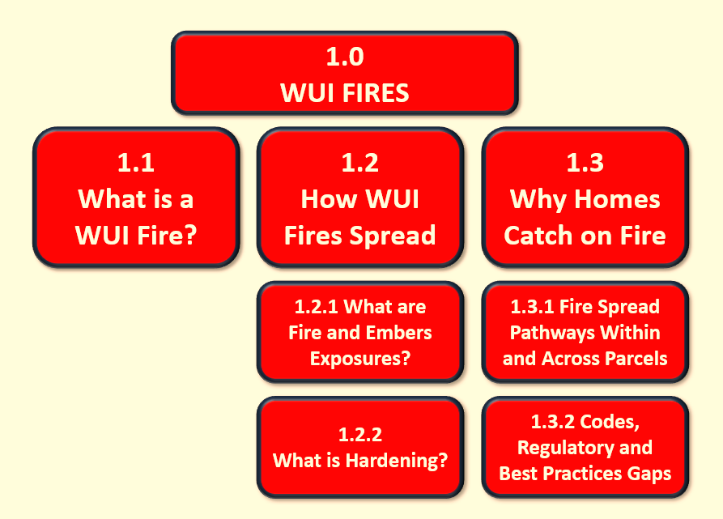
0.0 Escape
HMM-N ☑
< prev
next >
1.0 WUI FIRES 101
WEBPAGE 2ofX
1.1 What is a WUI Fire?
DEFINITION A Wildland Urban Interface (WUI) fire is a fire that burns in a WUI community
Where can WUI fires ignite?
There are two scenarios that can result or involve a WUI fire:
A WUI fire can ignite inside the community and under severe conditions spread across the community and then possibly also spread beyond the community to the wildlands, or
A fire can ignite in the wildlands, then spread and impact one or more WUI communities.
Why WUI event size maters?
The size of the WUI fire matters when it comes to house survivability. Because fire fighting resources are finite (there are only so many fire fighters and fire engines available), even moderate WUI fires can cause fire fighting resources to become insufficient (or “exhaust FF resources, resulting in…”) to protect every structure that is threatened, resulting in a large number of destroyed structures ranging from 100s to over 10,000 in a single disaster.
!
Actions with positive outcomes
For structures to survive large WUI fires, they must be able to withstand the event without any additional protection from fire fighters. Structures must be able to “stand alone.”
"Stand Alone": A WUI fire can burn down a thousand homes where there are not a thousand fire engines to save them. Therefore, a structure needs to “stand alone” to survive without first-responder interventions.
!
CAUTION!
Structures must be able to “stand alone.” Not evacuating and staying to defend your home can be extremely dangerous.
HOW DO WUI FIRES SPREAD? WUI fires spread by embers (airborne bits of burning fuel) and flames (radiation and convection).

Slide 3
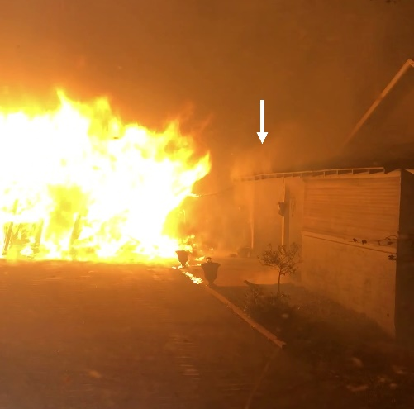
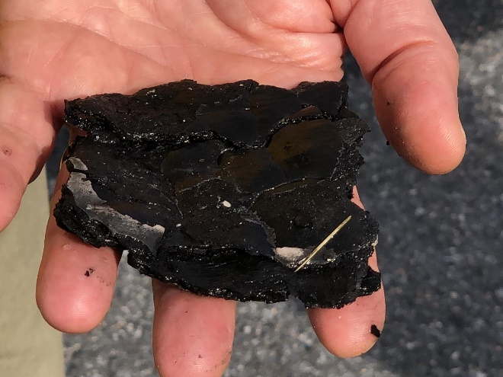
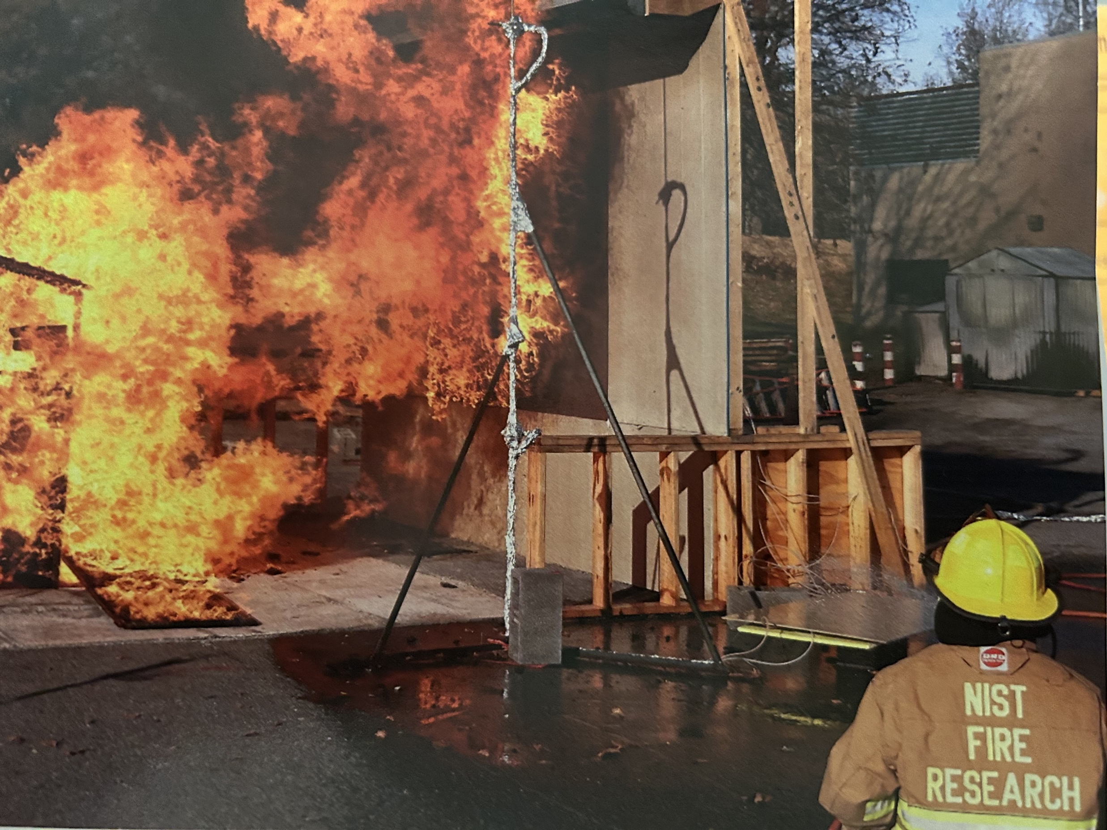
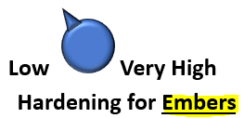
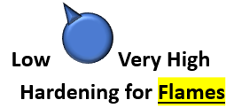
0.0 Escape
HMM-N ☑
< prev
next >
WEBPAGE 3ofX
1.0 WUI FIRES (continued)
What are Fire and Embers Exposures?
DEFINITION WUI Fire is both EMBERS and FLAMES
EMBERS and FLAMES
EMBERS: airborne bits of burning fuel | FLAMES: radiation and convection
Ember Exposures Ember exposures (or presence of embers) are inevitable in WUI fires and may be generated from burning vegetative or structural fuels. Embers can travel miles ahead of a wildfire and ignite spot fires ahead of the flaming front. Embers can ignite structures and parcel-level features such as parked vehicles, storage sheds, decks, and neighboring structures. Embers can vary in size and shape (see Figure xx). Ember ignitions may occur hours after the flame front has passed. Structure ignition from embers will depend on the vulnerabilities present on the structure and the intensity/duration of local ember exposures. Embers can be smaller than 1/8 of an inch or they can be large. This chunk of wood originated from a burning shed, observed and collected during NIST experiments. | Flame Exposures Flame exposures (radiation and convection) can originate from within the primary parcel or arrive from adjacent parcels or wildlands. Like ember exposures, flame exposures can vary in intensity (with heat fluxes [pop-up 1] up to about 200 kW/m2) and duration (seconds to tens of minutes [pop-up 2]). However, unlike embers that can travel from a few feet to several miles, fire exposures affect fuels in the range of tens of feet (up to ~300 ft), as radiation and convection decay rapidly with distance. Heat and flames from a fully involved shed or garage (13 ft x 26 ft) are about to ignite the primary structure. The white arrow points to the pyrolyzing eaves (off-gassing before ignition). Source: CAL FIRE, annotated by NIST.
Ember exposure scale | Fire / Flame exposure scale
The ember exposure scale is intended to illustrate that there is a range of ember exposures that can impact a structure. Ember exposure has various components (parts) including ember size, number of embers, and how much energy they have left when they land on a structure. (…when they land on something that can ignite) | The fire exposure scale is intended to illustrate that there is a range of fire exposures that can impact a structure. The fire exposure is measured at a specific location and is independent of the structure construction. Fire exposures are generated from burning fuels. Wind can impact fire exposure as it can “lean the flames” away or towards a house. Fire exposure decreases rapidly the further we measure from the flames. For exposures coming smaller combustibles like a 5x5 ft shed, five or ten feet can make a very big difference in fire exposure intensity.
POP-UP 1 ON WORDS “heat fluxes”
HOW STRONG IS THAT HEAT FLUX?
Heat Flux level | Time to injury | Heat Flux (HF) Description on human skin, etc
≈ 1.0 | 20 - 30 min | Typical HF of sunshine
2.5 |  | Fire fighter exposure and working environment
4.5 | 30 sec | second-degree burn
6.4 | 8 sec | second-degree burn, blisters
10 | 10 sec | second-degree burn, blisters
13 |  | wood volatiles ignite with flame exposure
16 | 5 sec | second-degree burn, blisters
20 | 4 sec | beginning of flashover in room
80 | 0 sec | seond-degree burns; flashover in a room
84 |  | level used to test protective clothing
170 |  | Post-Flashover fire in a burning room
Source: Lawson et al., "FIRE FACTS", NIST Special Pub. 1102
tsapps.nist.gov/publication/get_pdf.cfm?pub_id=903600
POP-UP 2 ON WORD “duration”
The Science Corner
It’s not just flux and it’s not just time. It’s the relationship between the two that meaningfully represents exposure.
ADD Ref to Tran, image of cone, plot of HF and LF
Low
Very High
Low
Very High (200 kW/m²)
Why these two exposures must be managed separately?
You can harden (protect) your home against fire and still loose it to an ignition from embers.
Example: you can harden your outside walls and install double-pane, tempered windows, and yet the house can still ignite from embers that enter the attic though an eave vent.
You can harden your home against embers and still loose the home to an ignition from fire/flames.
Example: you can install ember-resistant vents for your attic, but/and the house wall can ignite from flames hitting it from the nearby burning small shed [pop-up 3]
POP-UP 3 ON (at end of?) GRAY “Why these two…” BOX
Figure xx: Example of a structure hardened for embers with an ember- and flame-resistant eaves? vent and non-hardened wall. Exposure from a small shed (_ ft by _ ft), typically unregulated, placed 10 feet from house, resulted in structure ignition of the non-hardened wall.
SOURCE: xxxxxxxxxxxxxxxxxxxxx
ADD NOSSE REPORT REFERENCE AND TEST NUMBER hot link
!
Actions with positive outcomes
Structures need to be protected from both embers and fire. Hardened (or protected) structures help protect the entire community.
What is Hardening?
What is home (/Structure) hardening?
Hardening refers to actions taken to increase the ignition resistance of a structure; turning the blue knob to the right (Figure xx). More Hardening means harder to ignite.
What is the difference between hardening and hazard mitigation (hyperlink to section 3)?
Hardening focuses on the structure or home, mitigation is a broader term that can also be used when actions are taken to control/decrease exposures. Hazard Mitigation therefor can refer to either lowering exposures or hardening the structure.
There are several ways to successfully mitigate fire hazards (hyperlink to section 3).
To meet the two different types of exposures, the scale has two components: hardening for embers and hardening for fire.
Hardening for EMBERS | Hardening for FLAMES
Figure xx: Home Hardening Scales | Figure xx: Home Hardening Scales
The (ember?) hardening scale is intended to illustrate that there is a range of hardening that can be done on a structure. | The fire (/flame?) hardening scale conveys how “robust” the (a structure’s) construction is. Another way to say this is that very high fire (/flame?) hardening can withstand very high fire (/flame?) exposures.

Slide 4
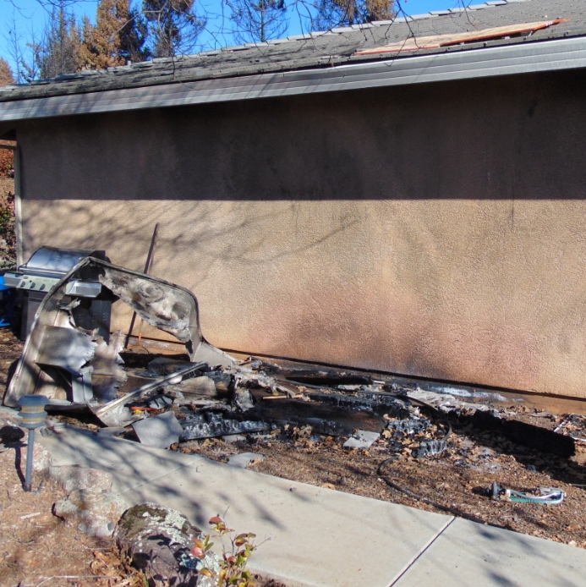
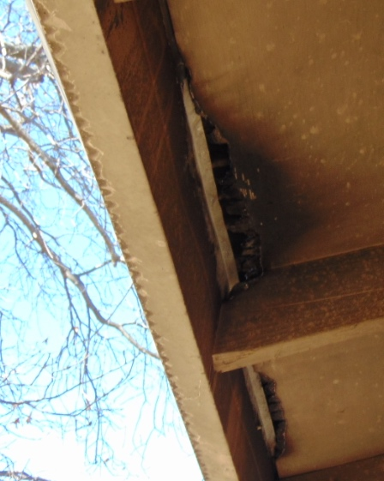
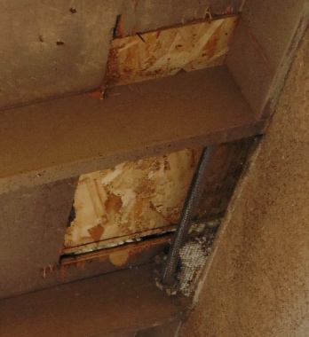
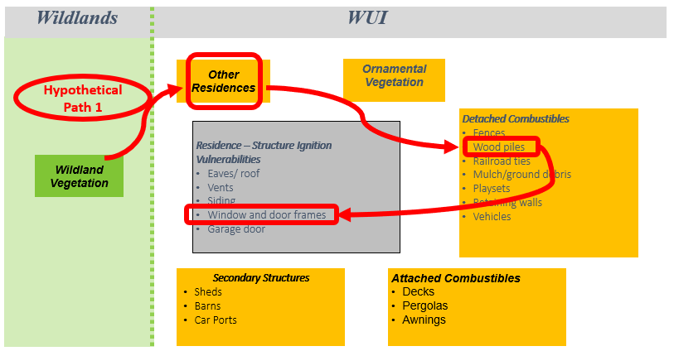
0.0 Escape
HMM-N ☑
< prev
next >
WEBPAGE 4ofX
1.0 WUI FIRES (continued)
Why Homes Catch on Fire
Why do homes catch on fire? Structures catch on fire due to an imbalance of exposure & hardening
Hardening, as previously described, is exposure-specific: hardening for flames and hardening for embers.
A structure ignites when there is an imbalance between hardening and exposures. Understanding the exposure – hardening connection makes it clear that preventing structure ignitions is not a single-solution problem This will be further explored in Section 2.1. Figure xx shows that both exposures and structure hardening may be managed to achieve hazard reduction. “the illustration below shows…
REDUCE EXPOSURE
HARDEN STRUCTURE
Managing WUI Fire Hazard can be done by using the two dials or (of?) exposure and structure hardening.
Features of a home, such as windows, eaves, deck/wall assembly, etc., are vulnerabilities only if the hardening is insufficient to “fight off” or withstand a specific fire or ember exposure (see HMM in Section 3.0)
Image of construction assembly
[ TOOL-TIP 1 ]
Embers can travel from a few feet to well over two miles
[ TOOL-TIP 2 ]
Fire/FLame exposures affect fuels in the range of tens of feet (up to ~300 ft), as radiation and convection decay rapidly with distance.
Fire Spread Pathways Within and Across Parcels
There are two different fire spread pathways to a house. A structure can ignite from embers that were generated “remotely” [TOOL TIP 1] or from near-by source of flames [TOOL TIP 2] (as discussed in Section 1.2)
Ignitions can occur very locally on a house. Figure xx illustrates several examples of ignition locations in the open eaves of a structure. In this case part of the fire exposure was from a boat stored against the house.
Figure yy illustrates possible structure ignition vulnerabilities (list not complete) and various typical fuels that are commonly found in the WUI. Structure ignition from fire can occur when the exposure from one of these fuels “overpowers” the hardening of the house. The NIST Case Study of the Camp Fire has identified various structure ignition pathways, outlined in Table xx. You can learn more about three of these scenarios by clicking on the example buttons (POP-UPS). The examples describe various documented fire spread pathways, showing how fire can “connect the dots” and get to the house.
NIST Photo. Camp Fire 2018.
NIST Photo. Camp Fire 2018.
NIST Photo. Camp Fire 2018.
Source: aluminum boat and supporting timbers
Failure: multiple locations along eaves
Failure: eave at facia board
Failure: eaves/roof truss near eave vent
Examples of Home Ignition Vulnerabilities and Ignition (failure) points. SOURCE: ??
WEBPAGE 4ofX
Continued
↓ ↓ ↓ ↓ ↓

Slide 5
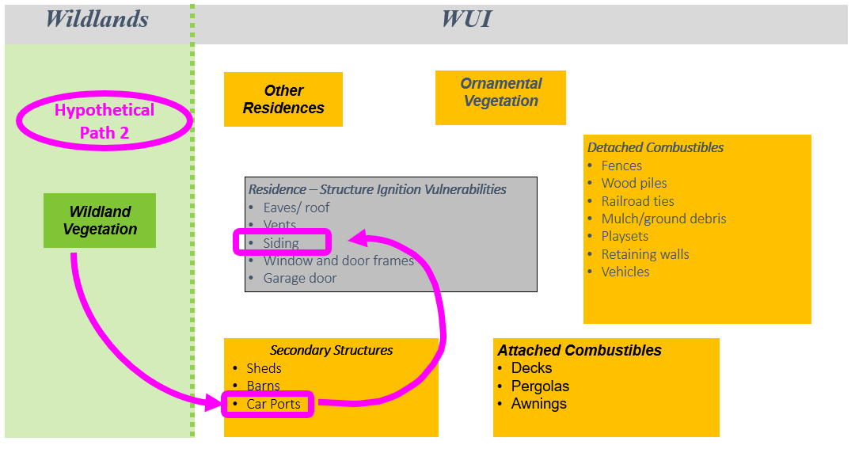
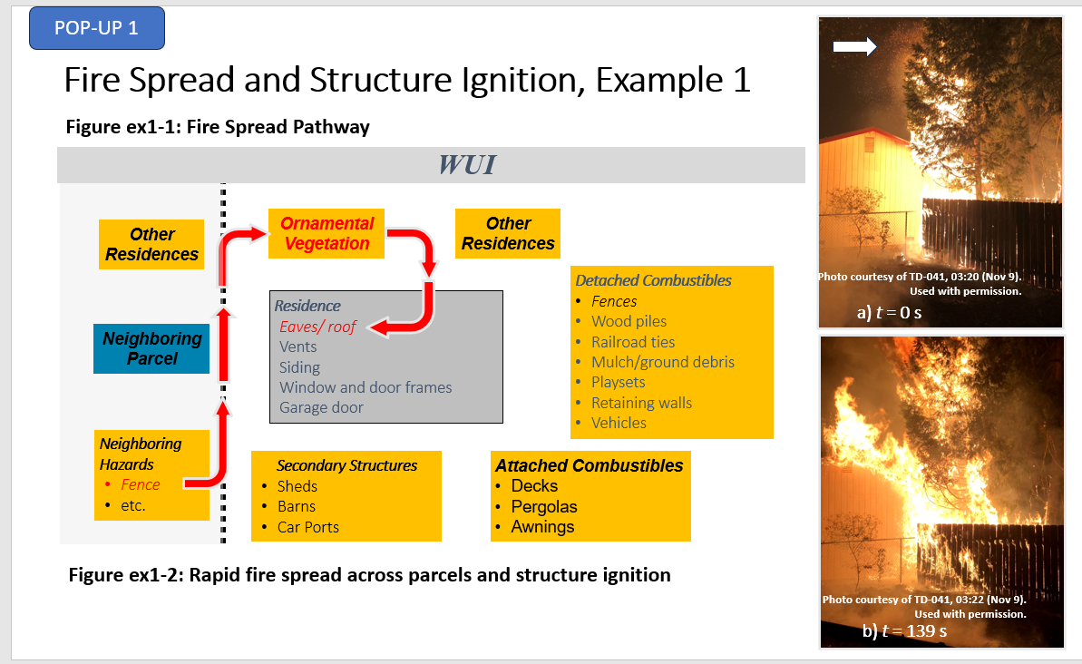
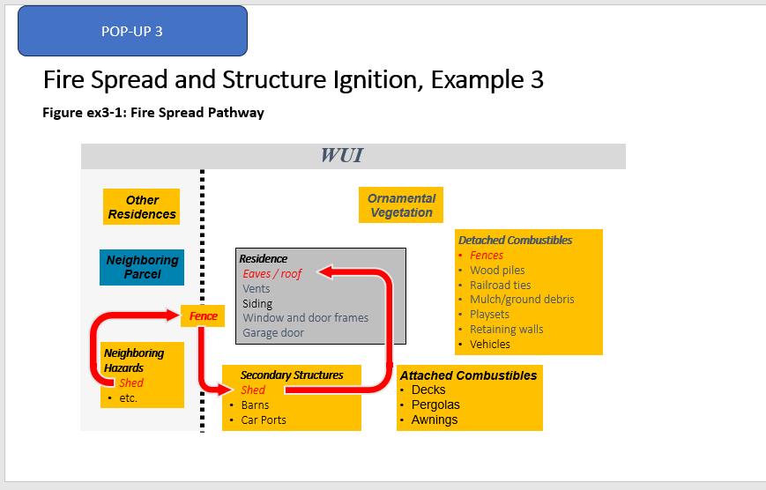
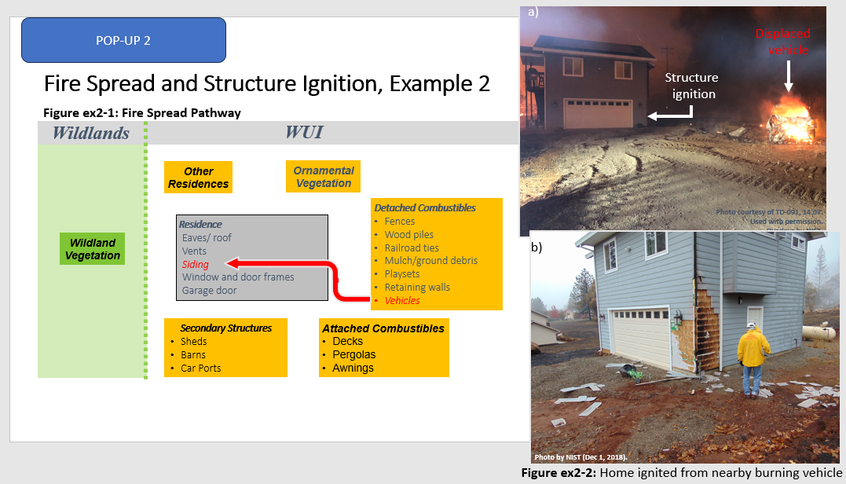
0.0 Escape
HMM-N ☑
< prev
next >
WEBPAGE 4ofX
continued
Fire Spread Pathways Within and Across Parcels (continued)
Table xx: Residential Structure Ignition Pathways Observed During the Camp Fire |  |  | Distance Between Source and Target
Pathway | Location ª | Building Ignition Pathway | meters | feet
MULCH and VEGETATION | Canyon View Dr | Bark mulch to wall of house (OSB and vinyl) | unknown
 | Neal Rd | Mulch to garage | unknown
 | Skyway | Juniper vegetation to eave | against house
 | Clark Rd | Juniper vegetation to house | 1.3 | 4
 | Neal Rd | Burning bark mulch into subfloor vents of house | unknown
DETACHED COMBUSTIBLES | Skyway | Fence to wall of building | 2.4 | 8
 | Valley Ridge Dr | Woodpile to house | 0.3 - 0.7 | 1 - 2
STRUCTURES | Sweetbriar Ln | Structure ignition via radiation from neighboring structure on fire | 11 | 35
 | Pearson Rd | Commercial structure to commercial structure roof to eave | 0.7 | 2
 | Sutter Rd | 8 m × 4 m (26 ft × 13 ft) shed to house eaves | 2.4 | 8
VEHICLES | Lewis Ranch Rd | Burning car to side of house | 1.5 - 2.4 | 5 - 8
 | Clark Rd | Boat on fire to eaves of house | 2.5 | 8
MULTIPLE HAZARDS | Chris Ct | Shed to fence to shed to house ^{b} | 2.7 | 9
 | Neal Rd | Burning car to shed to house | unknown
 | Valley Ridge Dr | Fence to boat to house | 2.7 - 3.6 | 9 - 12
 | Dade Ct, Magalia | Fence/ground fuel to tree to eaves of house | 1.5 | 5
New window 4a
“POP-UP 1”
New window 4b
“POP-UP 2”
New window 4c
“POP-UP 3”
WEBPAGE 4ofX
Continued
↓ ↓ ↓ ↓ ↓

Slide 6
0.0 Escape
HMM-N ☑
< prev
next >
WEBPAGE 4ofX
continued
1.0 WUI FIRES (continued)
Why Homes Catch on Fire
Gaps in Regulatory (or …) and Best Practices
The condition and particulars of a property are a result of potential interactions of multiple regulations, best practices and lifestyle choices. Table xx summarizes the relationships for three hypothetical scenarios (one the structure and two on the parcel). “A code by itself is not tell complete story”
Element | National WUI Code | State Code | Local Jurisdiction | Best Practice | Lifestyle Choice | WUI Community Hazard
SHEDS | Regulated sheds only above certain size | Regulates sheds only above certain size | HOA requires sheds to be below 120 ft² | Keep all sheds beyond x ft, ignition-resistant construction POP-UP this is widely xxx we need way more than the code to solve | Sheds are desirable for storing yard supplies and equipment | Small sheds present close to homes
EAVES | Eaves construction – open eaves allowed | Does not regulate | Requires open eaves construction for aesthetics | ??? | None | Open, non-hardened construction of exposed eaves that are? vulnerable to flame exposures
WOOD PILES | Firewood Pile regulated – national code not adopted | Does not regulate | Does not regulate | Keep at least 30 ft away from residence | Want firewood next to house for easy access | Firewood next to homes and along property lines.
Table xx: Illustration of hypothetical relationships between various codes, best practices, lifestyle choices. and hazards
Shonali/Chris: We can use IWUI Code here and use CA as an example of the state code
Or we can keep it generic.
Cleanup and add refs
Table xx illustrates that there are several ways a hazard may be mitigated from the national level all the way to local regulations, best practices and lifestyle choices.
Fire does not care about regulatory jurisdictions and local decisions. If there is a vulnerability, fire will try to take advantage of it and find a way to keep spreading.
Even if a building hardening feature is in a building code, it does not add value unless the code and the specific item are adopted, enforced, and maintained.
The following illustration demonstrates how WUI codes can add value and showcases some code limitations.
Table xx and Figure yy summarize that “how homes are built and what and where different fuels go on a parcel” is the result of many different regulations and choices.
WUI codes and best practices “buy us” fuels density up to a point.
!
What matters is that all the vulnerabilities at the structure and parcel are addressed to make sure that the structure can withstand the expected exposures.
What Codes buy us for Flames? Fuel Density – up to a point
POP-UP
NEW WINDOW 4d
POP-UP
NEW WINDOW 4e
SCENARIO 1: Not to WUI Code
SCENARIO 2: To WUI Code
×
CODE ADDS VALUE
✓
SSD 10 ft
SSD 10 ft
Small shed
Not to WUI Code
Small shed
WUI Code
CODE SAVES SPACE
POP-UP
NEW WINDOW 4g
POP-UP
NEW WINDOW 4f
SCENARIO 4: Not to WUI Code
SCENARIO 3: To WUI Code with Higher Exposure
SMALL PARCEL LIMITATION
CODE LIMITATION
×
✓
×
SSD ~15-20 ft
Animate Check marks x’s and Code…” arrows
SSD 5 ft
Not to WUI Code
Small shed
Not to WUI Code
Small shed
WUI Code

Slide 7
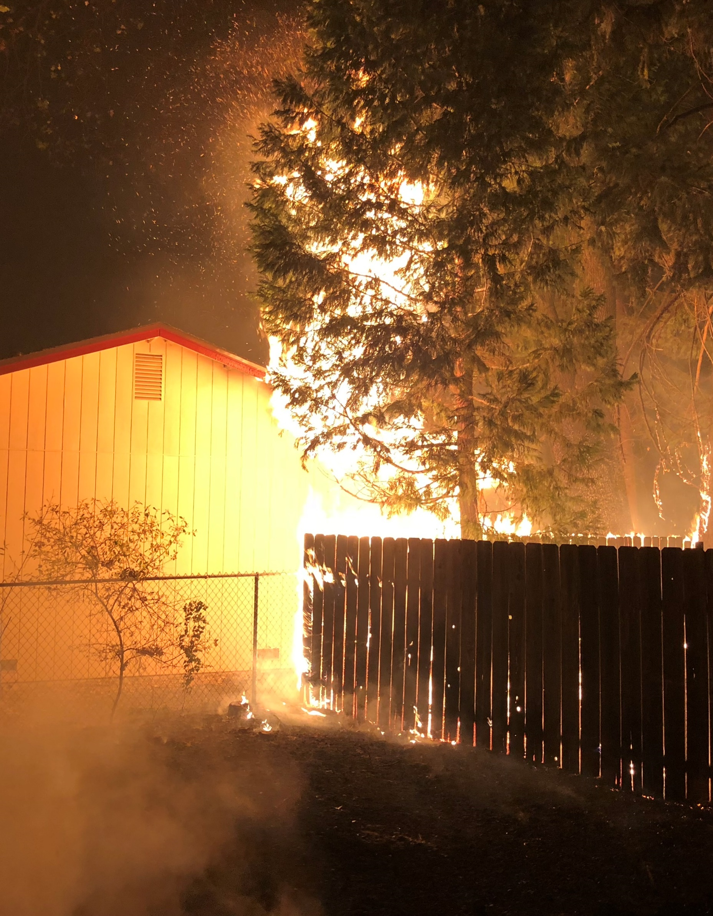
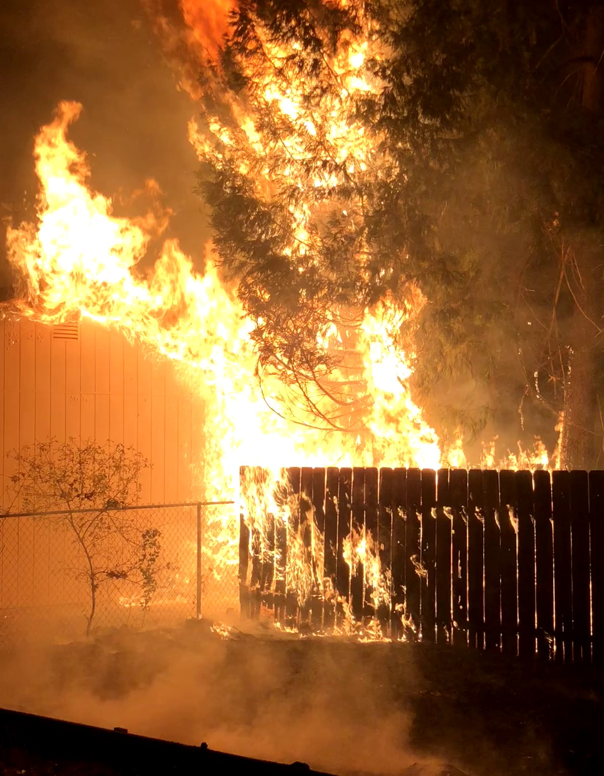
0.0 Escape
HMM-N ☑
< prev
next >
Fire Spread and Structure Ignition, Example 1
Figure ex1-1: Fire Spread Pathway
WEBPAGE 5ofX
4a New window
WUI
Other Residences
Ornamental Vegetation
Other Residences
Detached Combustibles
Fences
Wood piles
Railroad ties
Mulch/ground debris
Playsets
Retaining walls
Vehicles
Residence
Eaves/ roof
Vents
Siding
Window and door frames
Garage door
Detached Combustibles
Fences
Wood piles
Railroad ties
Mulch/ground debris
Playsets
Retaining walls
Vehicles
Photo courtesy of TD-041, 03:20 (Nov 9).
Used with permission.
Neighboring Parcel
Residence
Eaves/ roof
Vents
Siding
Window and door frames
Garage door
a) t = 0 s
Neighboring Hazards
Fence
etc.
Secondary Structures
Sheds
Barns
Car Ports
Attached Combustibles
Decks
Pergolas
Awnings
Photo courtesy of TD-041, 03:22 (Nov 9).
Used with permission.
b) t = 139 s
Rapid fire spread across parcels, and structure ignition
SOURCE: ???
Summary and Analysis of Example 1
The fire in this case (Figure ABOVE?) originated on an adjacent parcel. The pathway the fire took was:
Fence/Ground Cover ➔ Tree ➔ House
The parcel of the ignited structure has a chain link fence and non-combustible fence was directly connected to the house. It is the neighboring parcel that had a combustible fence (figure ex1-2) and it is that combustible fence together with the ground cover/litter that helped “bring the fire” to the property line. The height of the fence contributed as a “ladder fuel” lifting the flames from the ground and catching the tree on fire. The proximity of the large tree to the roof/gable of the house allowed fire to “reach the house”. This example highlights the weakness of selective hardening and how fire will take advantage of available pathways to spread and, in this case, “get to the house.” Also note how many embers were generated by the burning tree [arrow in image a)] further contributing to fire spread within the community.
The time between the two images is just over 2 minutes, highlighting how quickly fire can spread and ignite structures. This rapid fire spread further enhances the notion that structures must stand-alone; discussed in more detail in Section 2.1. There were no defensive actions because the water system had failed. The house was destroyed.
The Science Corner
All the structure ignition pathways help identify vulnerabilities. We cannot determine what works from the post-fire scene as we cannot quantify, after the fact, what were the fire and ember exposures with enough certainty.
What we can do is only identify possible scenarios that highlight weaknesses in exposure/hardening relationships. Laboratory work then helps further understand these relationships and guide building codes and best practices.

Slide 8
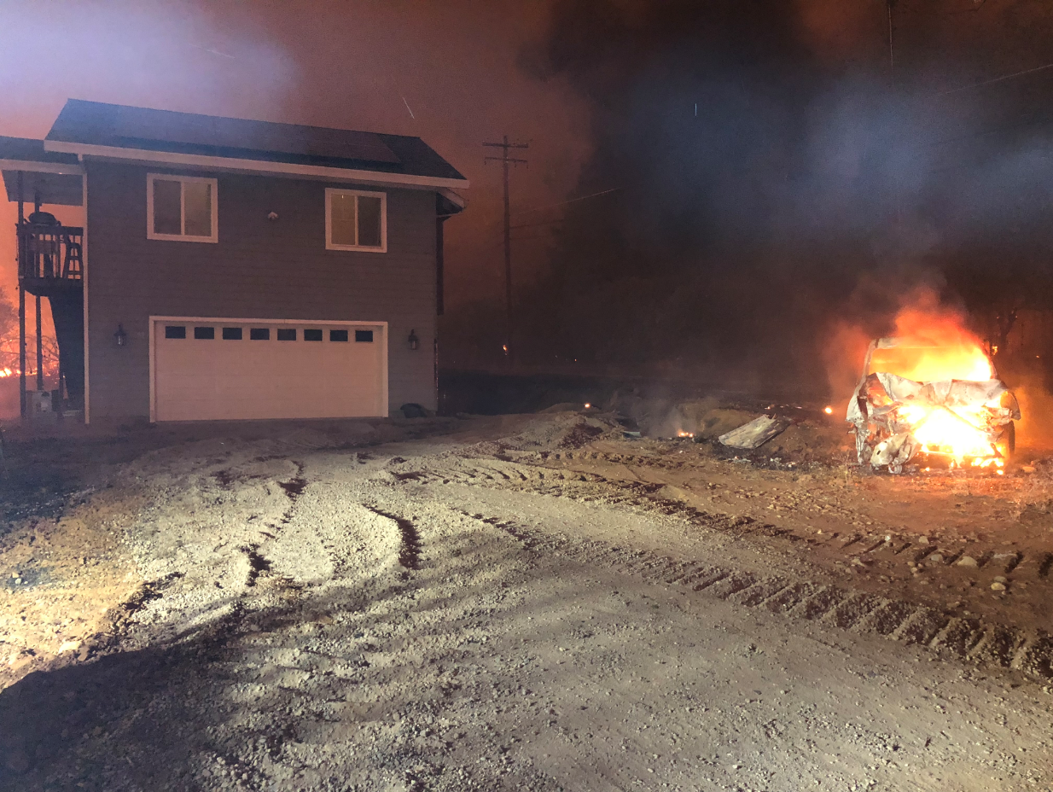
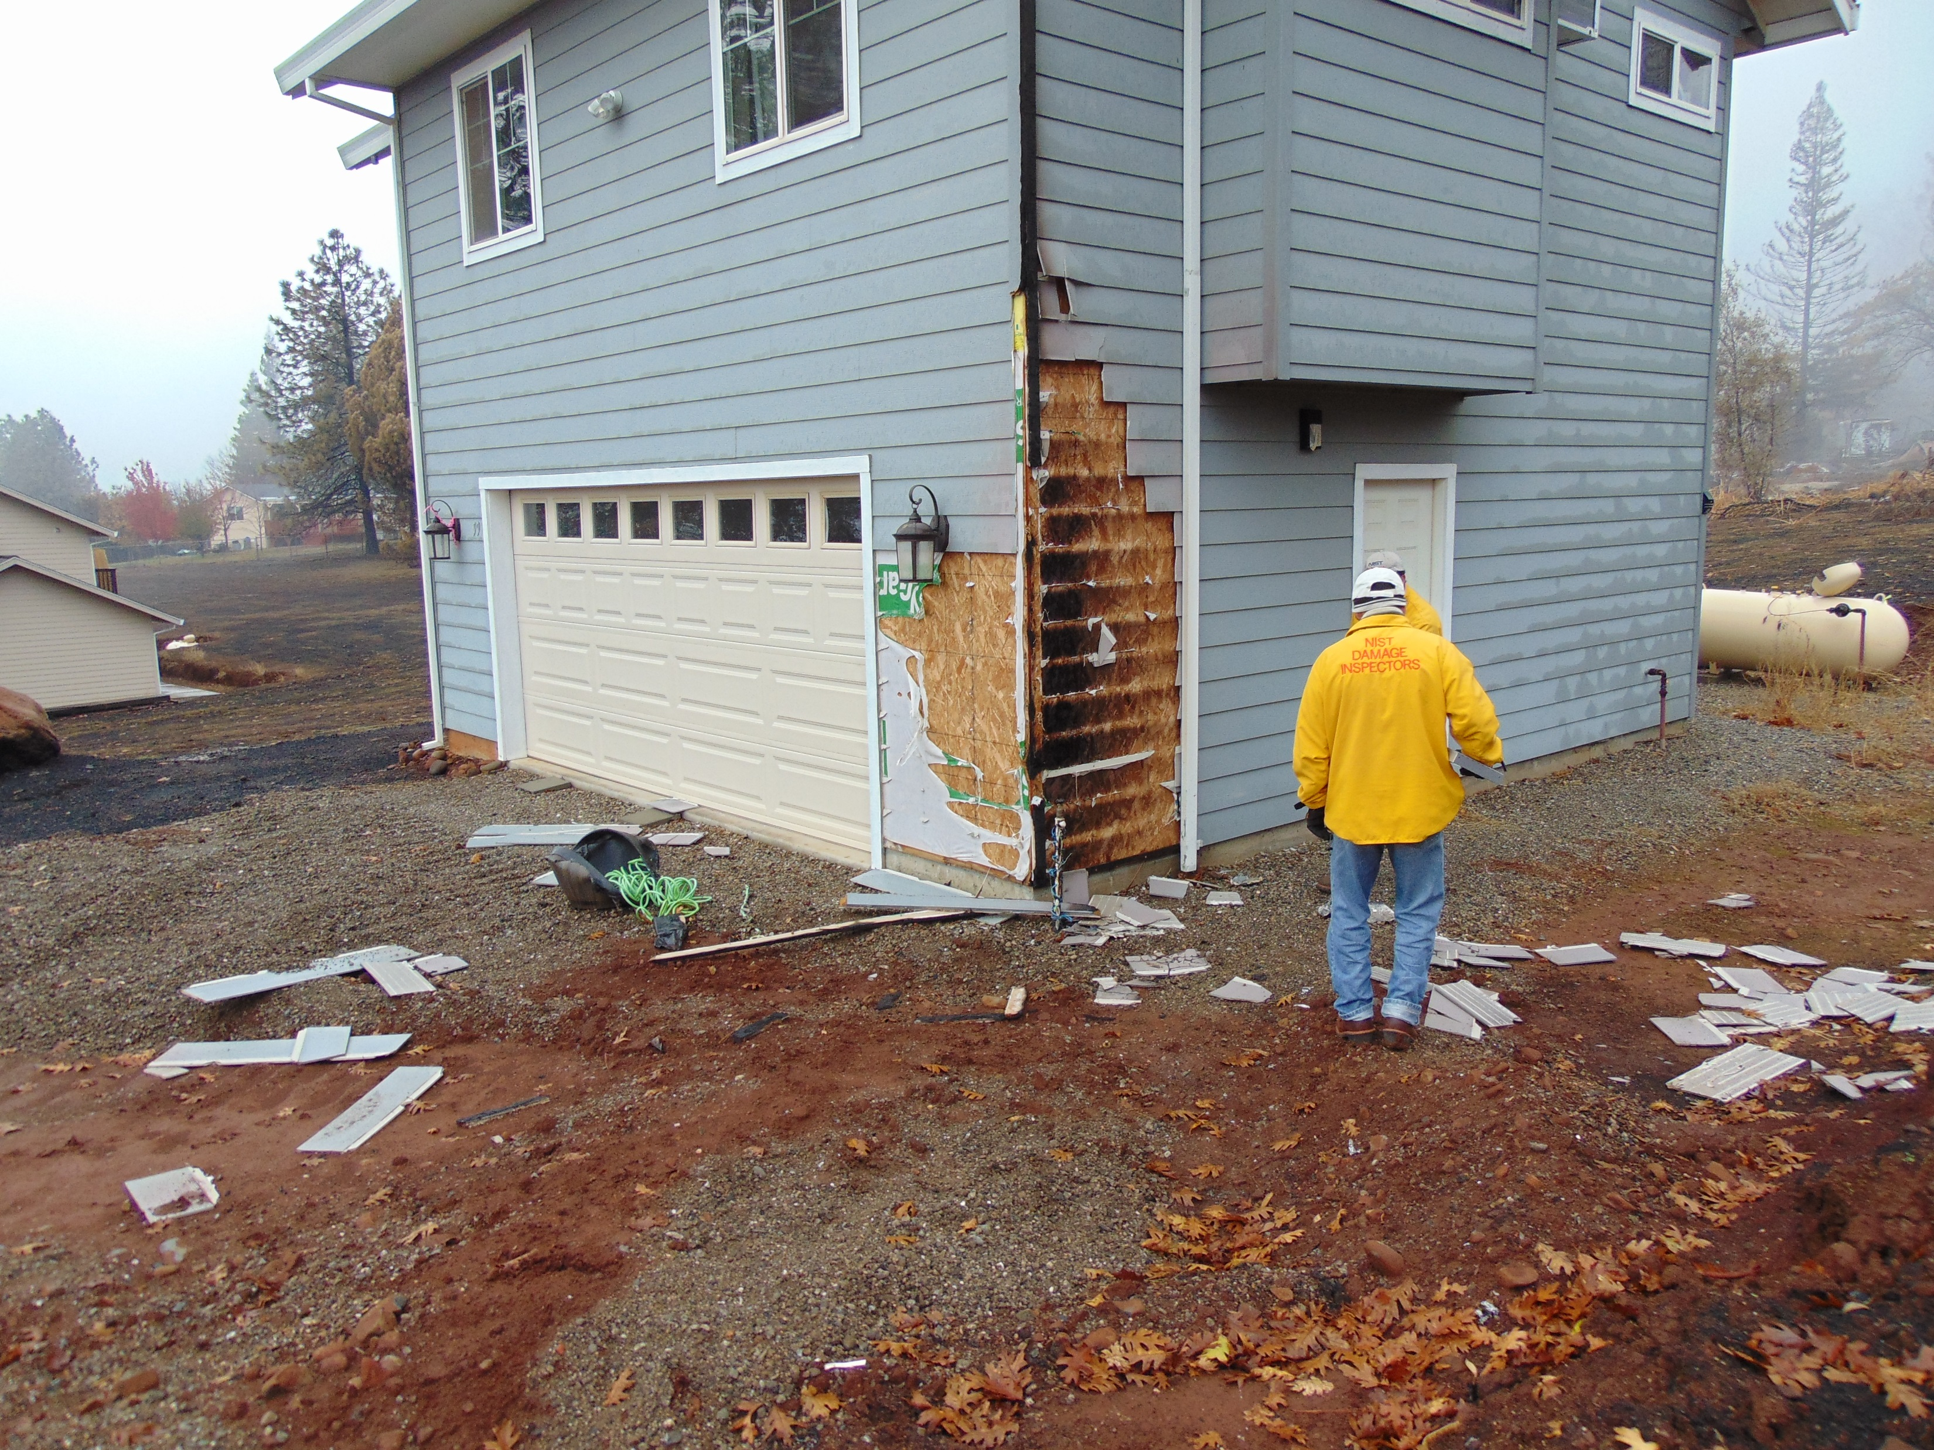
0.0 Escape
HMM-N ☑
< prev
next >
Fire Spread and Structure Ignition, Example 2
WEBPAGE 6ofX
4b New window
Figure ex2-1: Actual Fire Spread Pathway
Wildlands
WUI
Other Residences
Ornamental Vegetation
Detached Combustibles
Fences
Wood piles
Railroad ties
Mulch/ground debris
Playsets
Retaining walls
Vehicles
Residence
Eaves/ roof
Vents
Siding
Window and door frames
Garage door
Detached Combustibles
Fences
Wood piles
Railroad ties
Mulch/ground debris
Playsets
Retaining walls
Vehicles
Wildland Vegetation
Residence
Eaves/ roof
Vents
Siding
Window and door frames
Garage door
Secondary Structures
Sheds
Barns
Car Ports
Attached Combustibles
Decks
Pergolas
Awnings
a)
b)
Displaced
vehicle
8
Structure
ignition
Photo courtesy of TD-091, 14:07.
Used with permission.
Overlays by NIST.
Photo by NIST (Dec 1, 2018).
Home ignited from nearby burning vehicle
Summary and Analysis of Example 2
The WUI Science Corner
In this example, the NIST WUI Case Study methodology worked by connecting the NIST field observation hypothesis of a defensive action with the Technical Discussion of the first responder that saved the structure.
This connection was only possible because of the NIST WUI data collection methodology.
Not connecting the field observations to first responder actions frequently leads to wrong conclusions about house survivability and building code effectiveness. You can learn more about the NIST WUI Data Collection methodology in NIST TN 2296
In this structure ignition example (figure ex2), the house ignited from a burning car parked 5 to 8 ft away. This is an important example as it shows how dangerous vehicles can be when placed near a house. Variations of this scenario include a vehicle under a car port connected or adjacent to the house.
Vehicles are not designed to resist the fire and ember exposures in WUI fires and they can readily ignite. Unless placed in a closed garage, vehicles should be well away from structures. This will be further discussed in the Hazard Mitigation Methodology section 3.0.
In this case a defensive action was taken: a bulldozer operator (in the area at the time of structure ignition) was able to move the burning vehicle and “open up” the siding and save the structure. The top image (Figure ex2-1 a), taken by the bulldozer operator shows the fully involved car moved away from the house. The bottom image (b) was taken during the NIST field data collection effort, where evidence of a defensive action was collected. Subsequent data collection was used to find the bulldozer operator who saved the house and confirm the defensive action. To learn more about the NIST WUI Case Studies check out The WUI Science Corner

Slide 9
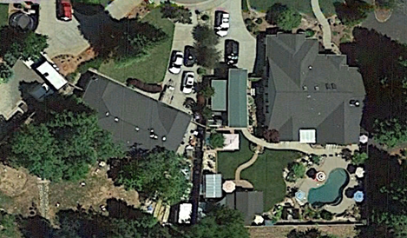

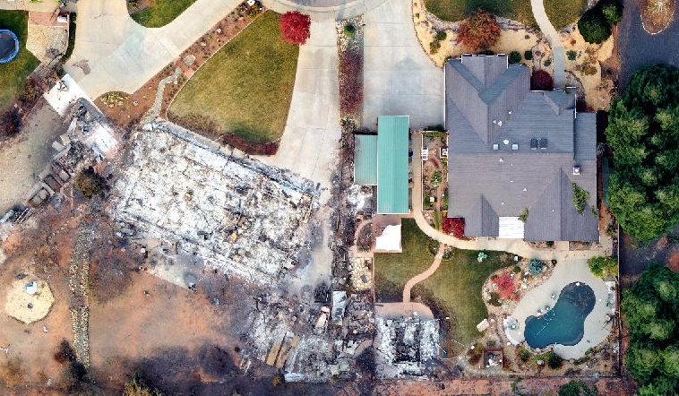
0.0 Escape
HMM-N ☑
< prev
next >
Fire Spread and Structure Ignition, Example 3
WEBPAGE 7ofX
4c New window
Fire Spread Pathway
WUI
Other Residences
Ornamental Vegetation
Detached Combustibles
Fences
Wood piles
Railroad ties
Mulch/ground debris
Playsets
Retaining walls
Vehicles
Neighboring Parcel
Detached Combustibles
Fences
Wood piles
Railroad ties
Mulch/ground debris
Playsets
Retaining walls
Vehicles
Residence
Eaves / roof
Vents
Siding
Window and door frames
Garage door
Residence
Eaves/ roof
Vents
Siding
Window and door frames
Garage door
Fence
Fence
Neighboring Hazards
Shed
etc.
Neighboring Hazards
Sheds
etc.
Attached Combustibles
Decks
Pergolas
Awnings
Secondary Structures
Shed
Barns
Car Ports
Summary and Analysis of Example 2
This example illustrates fire spread between two parcels across multiple fuels. The fire spread pathways (Figure ex3-1) the fire took was Shed ➔ Fence ➔ Shed ➔ House
An assessment of these two parcels identifies two areas with limited space for auxiliary fuels. Both areas shown [figure ex3-2, a)] had fuels agglomerated on the property boundaries (red highlights). This will be further discussed in the Hazard Mitigation Methodology section 3.0.
The area highlighted in yellow [figure ex3, a)] presents a location where some fuels could be placed with reduced impact on residential structures.
The lower figures [ex3-2 b) pre-fire and c) post-fire] show before-fire and after-fire imagery with the actual fire spread pathway highlighted (Camp Fire, NIST TN 2135).
In this example, the presence and proximity of three fuels (all unregulated) resulted in fire spreading to the structure and igniting the eaves, then the roof.
First responders in the area attended (attempted?) to reduce exposure and save the house.
Highly flammable contents of the second shed that ignited resulted in the shed exploding and injuring a firefighter.
The structure ignited in the eaves, and the rapid progression of the fire prevented any further defensive actions. The house was destroyed.
Imagery: Google Landsat/Copernicus, Overlays NIST
a)
Limited space for auxiliary fuels
Available space for auxiliary fuels with limited impact on residential structures
Limited space for auxiliary fuels
Imagery: Google, Landsat/Copernicus. Overlays by NIST.
b)
Imagery: Butte County GIS. Overlays by NIST.
c)
Fire spread across two parcels and multiple fuels resulting in house ignition and loss

Slide 10
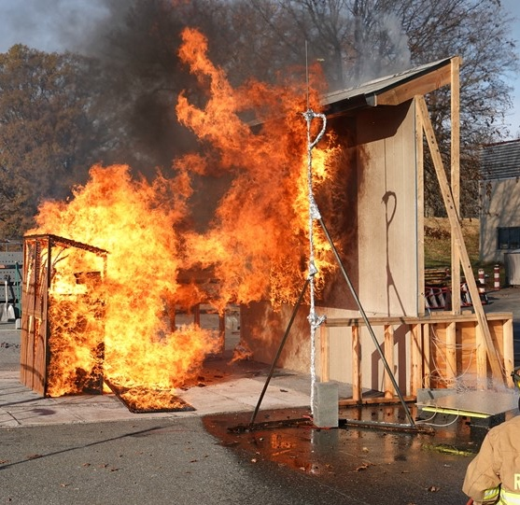
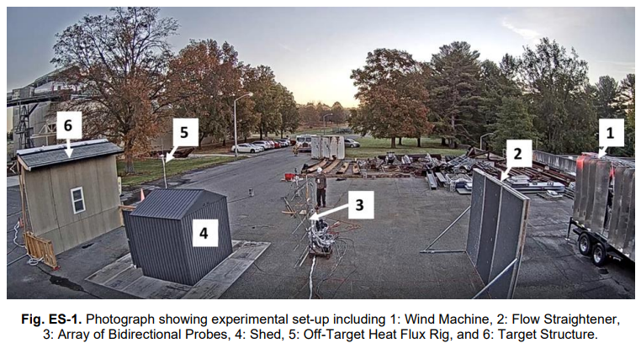
0.0 Escape
HMM-N ☑
< prev
next >
WEBPAGE 8ofX
4d New window
Wall Assembly is
Not BUILT To WUI Code
Scenario 1: Ignition of a Wall Assembly Not to WUI Code
This scenario shows the ignition of a house from fire exposure. In this scenario, this house wall and window were not to code, and the house ignited.
The flames exposure was from a Very Small (5.6 ft by 4.6 ft) wooden shed, 10 feet away from the house. Very Small refers to the size binning as selected for the NIST experiments.
The experiment was conducted with wind (wind blowing from left to right). The wind, generated by a wind machine, leaned the flames towards the house.
To learn more about these experiments check out The WUI Science Corner
The WUI Science Corner
NIST WUI Case Studies have identified structure-to-structure spread as an important contributor to structural losses in the WUI.
NIST together with Federal , state and NGO partners conducted a series of structure-to-structure fire-spread experiments to provide placement guidance for small (typically unregulated) sheds.
Several experimental series have been conducted with and without wind.
Laboratory experiments without wind were conducted in the National Fire Research Laboratory to measure the energy release (Heat Release Rate) of the different sheds. Outdoor experiments, with applied wind, were conducted to determine the effects of wind on flame lean and structure separation distance.
You can learn more about structure-to-structure fire spread and structure separation distance (SSD) at SSE WEBSITE LINK
Figure xx: NIST experimental setup for the Shed SSD experiments with wind
NOSSE 13 O-WVShw-10
Pre-fire Image

Slide 11
0.0 Escape
HMM-N ☑
< prev
next >
WEBPAGE 9ofX
4e New window
Code Benefits and Limitations POP-UPS
Scenario 2 - No Ignition of a Wall assembly built to WUI Code
In this scenario the house wall and window are built to WUI Code, and the house resists the flames exposure. The value added from the WUI Code construction is clear when comparing this Scenario to Scenario 1 that ignited.
The fire exposure was identical to Scenario 1; from a Very Small (5.6 ft by 4.6 ft) wooden shed placed 10 ft away from the house.
The experiment was conducted with wind (wind from left to right) that leaned the flames towards the house.
To learn more about these experiments check out The WUI Science Corner
BUILT to WUI Code
The WUI Science Corner
NIST WUI Case Studies have identified structure-to-structure spread as an important contributor to structural losses in the WUI.
NIST together with Federal , state and NGO partners conducted a series of structure to structure fire-spread experiments to provide placement guidance for small (typically unregulated) sheds.
Several experimental series have been conducted with and without wind.
Laboratory experiments without wind were conducted in the National Fire Research Laboratory to measure the energy release (Heat Release Rate) of the different sheds. Outdoor experiments, with applied wind, were conducted to determine the effects of wind on flame lean and structure separation distance.
You can learn more about structure-to-structure fire spread and structure separation distance (SSD) at SSE WEBSITE LINK
Figure xx: NIST experimental setup for the Shed SSD experiments with wind
NOSSE 3 O-WVShw-10

Slide 12
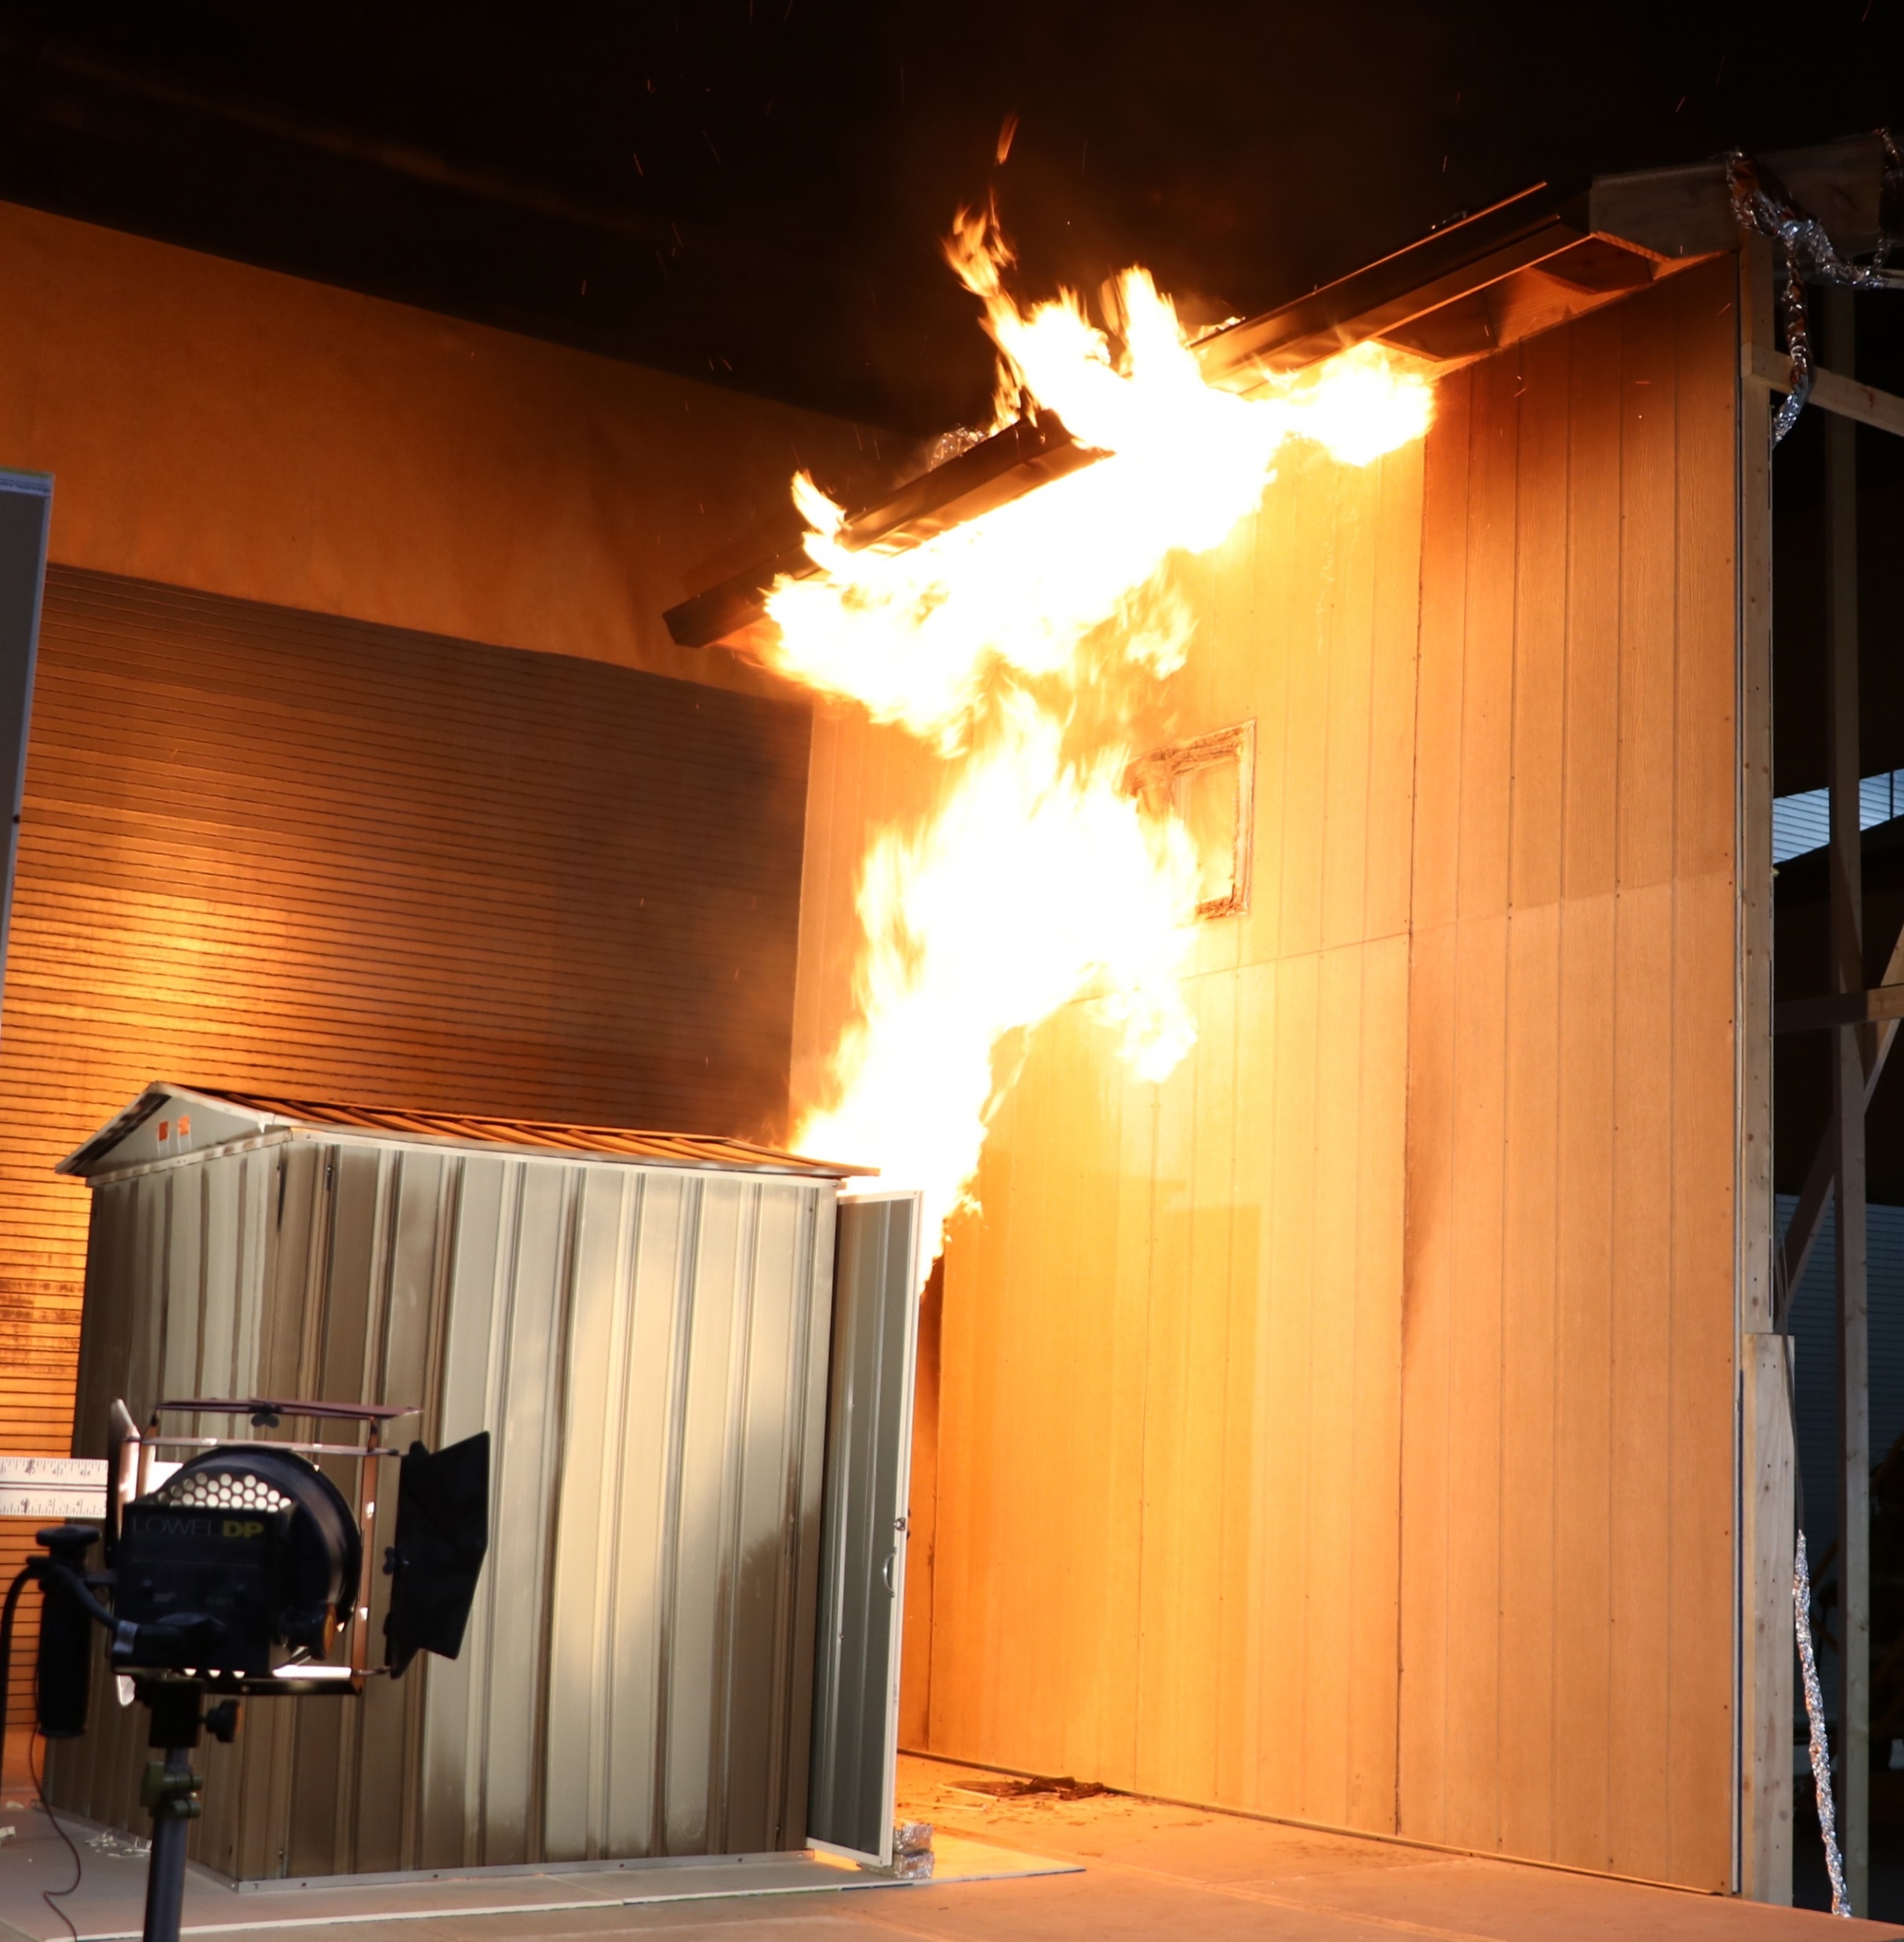
0.0 Escape
HMM-N ☑
< prev
next >
Code Benefits and Limitations POP-UPS
WEBPAGE 10ofX
4f New window
Scenario 3 - Ignition of a Wall assembly built to WUI Code
In this scenario the house wall and window are built to WUI Code, and the house ignites from the flames exposure.
The flames exposure was from a a Very Small (4.6 ft by 4.25 ft) steel shed placed 5 ft away from the house.
This shed configuration is unregulated in most jurisdictions, resulting in potential home ignitions even if the home is built to WUI Code.
The experiment demonstrates that, while the WUI Code added value in Scenario 2, this configuration, with the larger flames-exposure, exceeds the ignition resistance provided by the WUI code and the house ignites.
To learn more about these experiments check out The WUI Science Corner
To Code
The WUI Science Corner
NIST WUI Case Studies have identified structure-to-structure spread as an important contributor to structural losses in the WUI.
NIST together with Federal , state and NGO partners conducted a series of structure to structure fire-spread experiments to provide placement guidance for small (typically unregulated) sheds.
Several experimental series have been conducted with and without wind.
Laboratory experiments without wind were conducted in the National Fire Research Laboratory to measure the energy release (Heat Release Rate) of the different sheds. Outdoor experiments, with applied wind, were conducted to determine the effects of wind on flame lean and structure separation distance.
You can learn more about structure-to-structure fire spread and structure separation distance (SSD) at SSE WEBSITE LINK
Figure xx: NIST experimental setup for the Shed SSD experiments with wind
NISSE 1B-SVSh0-5
CAPTION: ??????????

Slide 13
0.0 Escape
HMM-N ☑
< prev
next >
Code Benefits and Limitations POP-UPS
WEBPAGE 11ofX
4g New window
Scenario 4 – Fuel Spacing and Housing Density
In this scenario the house (on the left) is not hardened for flames and the shed is placed far enough (greater than 15-20 ft) that the flames will not cause any ignition.
The lack of hardening of the wall and window are addressed by having more space between the house and the shed.
This approach only works when the following two requirements are met:
There is sufficient space for the shed to be “pushed away” from the house AND
The shed is not close enough to the property line to cause problems for the surrounding property(s).
Scenario 4 meets the first requirement but does not meet the second requirement as the house on the right can ignite from the fire exposure generated by the shed.
The above two requirements show that:
There are limitations to the fuels than can be placed on smaller lots (parcels).
Simply moving fuels away from the house is not necessarily a wise fire-mitigation solution.
The second requirement is essential to reducing fire loses.
To learn more about these experiments check out The Science Corner
The WUI Science Corner
NIST WUI Case Studies have identified structure-to-structure spread as an important contributor to structural losses in the WUI.
NIST together with Federal , state and NGO partners conducted a series of structure to structure fire-spread experiments to provide placement guidance for small (typically unregulated) sheds.
Several experimental series have been conducted with and without wind.
Laboratory experiments without wind were conducted in the National Fire Research Laboratory to measure the energy release (Heat Release Rate) of the different sheds. Outdoor experiments, with applied wind, were conducted to determine the effects of wind on flame lean and structure separation distance.
You can learn more about structure-to-structure fire spread and structure separation distance (SSD) at SSE WEBSITE LINK
Figure xx: NIST experimental setup for the Shed SSD experiments with wind

Slide 14
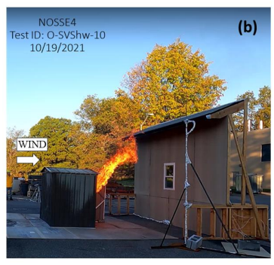
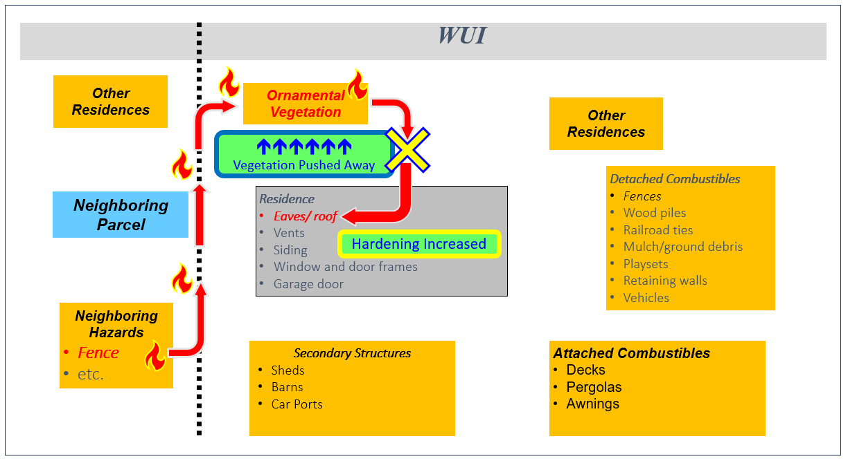
0.0 Escape
HMM-N ☑
< prev
next >
WEBPAGE 12ofX
2.0 Rethinking House Survivability: Breaking the Fire Spread Pathways
There are three distinct sets of actions, two for flame exposures? and one for ember exposures, that should be taken to break the fire spread pathways explored in Section 1.3.
2.0
Rethinking House Survivability
Breaking Flame-Spread Pathways
There are two options to address fire spread pathways via flames:
Reduce the exposure
Harden the home or structure.
Exposure reduction can be achieved using the 3 Rs (Reduce, Remove, Relocate) described in Section 3.0, PPO-UP 6. This may be possible in certain scenarios when the fuel is small and readily/easily movable, like a shed or woodpile. This option will not be available when the exposure comes from a “fixed” source, like a neighboring home.
The second option is to harden the home. Section 3.0 POP-UP 5 will explore scenarios where this option should be considered, and others where it should not.
In some situations, both options can work together to get the home not to ignite, as shown in POP-UP 6, Section 3.0
Breaking Ember-Spread Pathways
There is only one option with preventing structure ignition from embers and that is to harden the structure.
Why? This is necessary as ember exposures cannot be controlled or eliminated.
It is essential to address all structure vulnerabilities that can result in an ignition from embers. As discussed in section 1.0 during a severe WUI fire, a structure may be “hit” by a million embers. Not fully hardening for embers is gambling that none of the million embers will “find” the remaining weaknesses.
Exposure Reduction
of Flames
Home Hardening
For Embers
Home Hardening for Flames
To successfully and efficiently reduce structure ignitions, we must change how we tackle the WUI fire problem and move from a mandate-based approach to a performance-based approach to make homes stand alone.
By using a performance-based approach, we can address all the gaps between different jurisdictions and best practices illustrated in Section 1.3.2. Another way to say this is that we must use a Code-Plus approach.
HMM is designed specifically as a performance-based approach designed to address all exposure - structure hardening vulnerabilities.
Figure xx illustrates how implementing HMM addresses a specific structure protection gap, namely the hazard associated with small sheds. In Figure xx (a) the hardened home is ignited from a typically unregulated small shed 5 ft away from the house. In Figure xx (b) the same shed, now 10 ft away, no longer ignites the home, and the house will “stand-alone.”
HMM is presented in Section 3.0. All the HMM lessons are presented in the interactive NIST Virtual WUI Community in Section 4.0.
(a)
NISSE 1B-SVSh0-5
Figure xx: Vulnerability from shed exposure to Code Compliant Home (a) above, Successful implementation of HMM by displacement of shed from 5 ft to 10 ft from the house (b) below
make composite, break last connection so fire progresses but doesn't make it to the house, x on line, pointing to two solutions - exposure reduction or hardening increase push fuels away or harden structure

Slide 15
0.0 Escape
HMM-N ☑
< prev
next >
3.0 What is HMM?
WEBPAGE 13ofX
What is HMM, and how is it different from traditional Fire Hazard Mitigation Approaches?
Foundations of HMM
Based on Exposures – not parcel based POP-UP 3a
Addresses both fire and ember exposures POP-UP 3b
Comprehensive not optional (see 1.1 Why Good Enough does not work in WUI Fires)
Acknowledges the impacts of Fuels Agglomeration (fuels near each other) POP-UP 3c
Acknowledges the negative impacts of placing fuels at the edge of the property POP-UP 3d
Additional Benefits
HMM is designed to limit retrofit expenses POP-UP 3e
HMM provides implementation solutions that leverage structure, parcel and neighborhood specifics POP-UP 3f
HMM illustrates the effects of partial hardening on community losses as a function of housing density
3.0
What is HMM?
HMM Features/Benefits | Other Mitigation Approaches
HMM is exposure based Why? Fire does not care about ownership. This is one of the fundamental differences between HMM and other approaches. | Almost all other approaches are Parcel Based Why? Historical context, mitigation has been historically addressed at the parcel level, as this is easier to convey and regulate
HMM addresses exposures from both fire and embers. Why? Because all exposures that can result in structure ignition must be addressed. | Do not address all exposures, specifically the ones that are hard to mitigate or belong to someone else on a neighboring property.
HMM requires hardening for all ember vulnerabilities (weak spots) Why? Because when your house get bombarded by one million embers, they will find that weak spot. Fire is like water going down hill: it will find the path of least resistance and get your house ignited. | Make ember hardening voluntary or partial, or provide tiered hardening systems
HMM acknowledges that certain exposures cannot be mitigated and focuses on ignition prevention in these situations Why? Acknowledging the limitations of hardening can save retrofit funds and point to the necessary steps to prevent structure ignitions | Does not address impacts of moderate and high-density construction
HMM acknowledges the relationships between partial hardening and community structure losses Why? HMM points to the “very high standards” that have to be maintained to prevent high-density communities from suffering extreme losses. | Do not address the impacts of partial mitigations on community losses

Slide 16
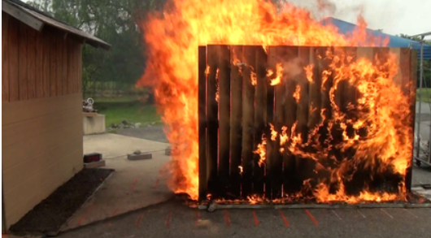
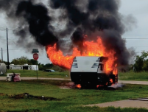
0.0 Escape
HMM-N ☑
< prev
next >
WEBPAGE 14ofX
HMM accounts for:
Fuels that are unregulated (example: parallel fences, figure xx).
Why this matters? This is important because even relatively small exposures if combined with a home vulnerability can result in structure ignition and loss.
Fuels and exposures that come from another property (example: an RV on a neighboring property).
Why this matters? This is important because fire does not care about property lines. The fire and ember exposures (from a burning RV, figure yy) to a nearby structure are driven by local conditions, such as wind, and not by property lines.
Parallel Fences from Virtual Community
POP-UP 3a NEW WINDOW
Parallel fences in NIST Virtual WUI Community and from Fence Experiments showing extent of Flame Exposures
RV from Virtual Community
RV in NIST Virtual WUI Community and from RV Fire Experiment showing extent of Flames

Slide 17
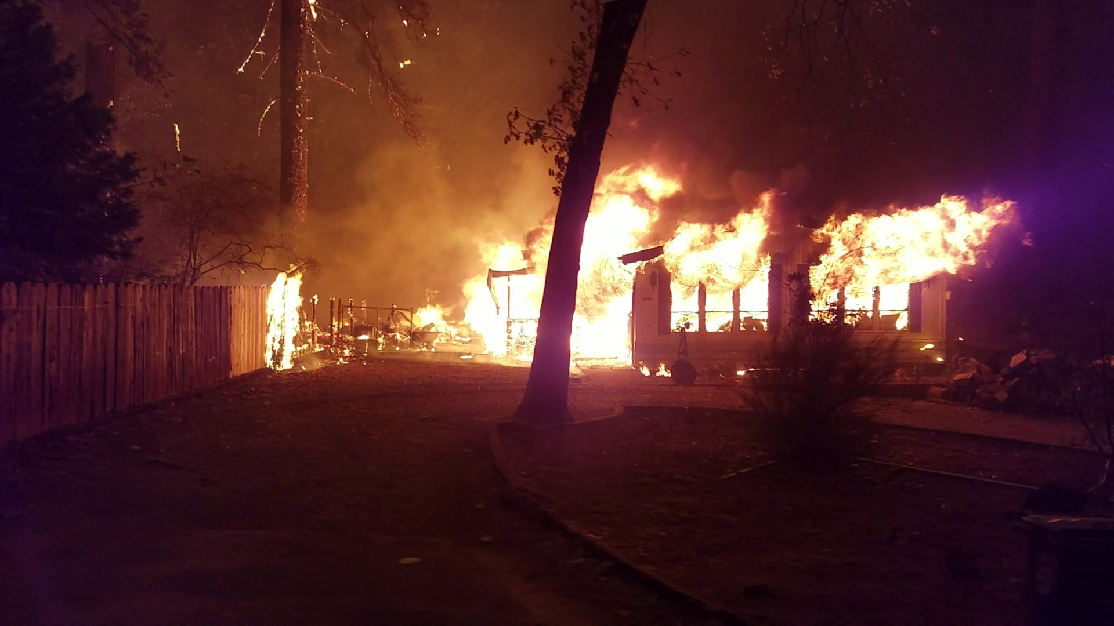
0.0 Escape
HMM-N ☑
< prev
next >
WEBPAGE 15ofX
TD-101 replace
Fire Exposures are local (as discussed in Section 1.2)
Why it matters? The imbalance between a fire exposure to a structure and the hardening of the structure can result in home ignition and loss.
Embers hitting a house can come from the same parcel or from a mile or more away.
Why it matters? Ember exposures can be severe. In a WUI conflagration a structure may be impacted by a million embers (figure yy) making it to find any weak spots on a home, resulting in ignition and loss. You cannot stop embers, so you have to protect against them
POP-UP 3b NEW WINDOW
Photo courtesy of TD-101, 12:22.
Used with permission.
Fully involved house generating Flame Exposures to surroundings
SOURCE: ???
Camp Fire Embers Short Video from PPD on Skyway
!
You can harden your home for fire and lose it to embers, or the other way around. HMM requires that you fully address both problems
Video showing embers across egress artery, during the Camp Fire, Paradise CA
SOURCE: ???

Slide 18
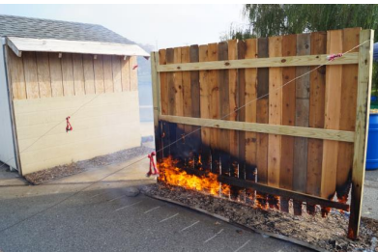
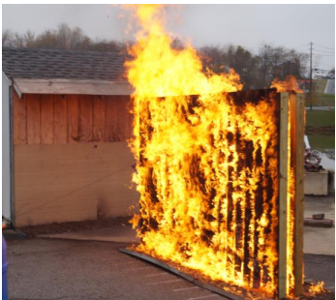
0.0 Escape
HMM-N ☑
< prev
next >
Fuels Agglomeration: Fuels in close proximity to each other significantly increase fire and ember exposures.
NIST experiments with combustible fences illustrate this hazard.
Figure xx (a) shows a single privacy fence on fire and (b) two parallel privacy fences (8 inches apart). The fire exposure increase is clearly visible.
What does this mean for home hardening and fuels management?
Where one fuel at some distance from your home may not a problem, the addition of another fuel near it can change the entire exposure and the new “fuels package” can now cause a home ignition.
WEBPAGE 16ofX
POP-UP 3c NEW WINDOW
(a)
(b)
The effects of Fuel Agglomeration are visible in the fire behavior between a single and a double privacy fence. Both experiments were conducted with wind (from left to right)

Slide 19
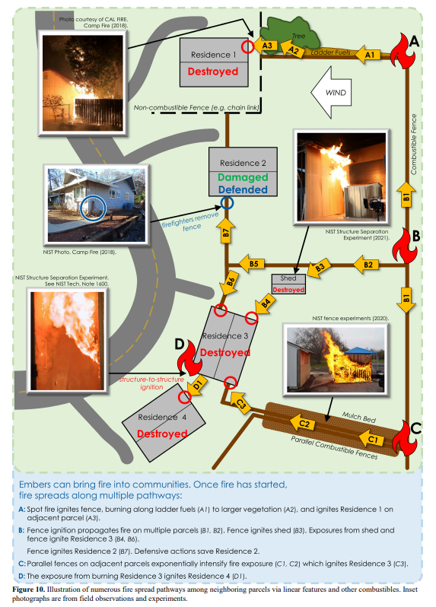
0.0 Escape
HMM-N ☑
< prev
next >
Pushing fuels to edge of property is not a solution
Parcel-to-parcel exposure (POP-UP 3a) and fuels agglomeration (POP-UP 3c) can create “fuels corridors” near property lines.
Why it matters?
“Fuels corridors” can act as wicks that help spread fire between properties, increasing structure ignitions within a neighborhood or community.
Figure from Virtual Community
WEBPAGE 17ofX
POP-UP 3d NEW WINDOW
Example of fuels corridor in the NIST Virtual WUI Community

Slide 20
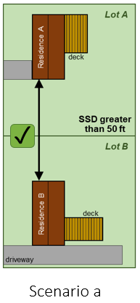
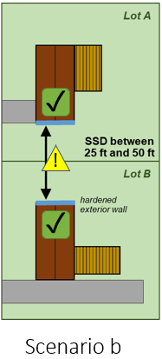
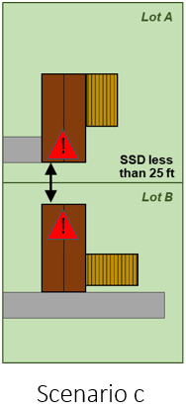
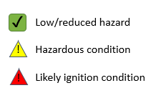
0.0 Escape
HMM-N ☑
< prev
next >
WEBPAGE 18ofX
Implementing HMM in Moderate and High-Density Communities
In moderate- and high-density communities, fire spread from structure to structure must be explicitly addressed.
HMM makes the following assumptions:
If there are 50 ft or more between homes (figure xx, scenario a) there will be little direct flaming exposure between the two structures. Limitations of this estimated distance include very large burning homes, steep terrain, and the explicit assumption that there are no cars, RVs, heavy vegetation, or other fuels between the structures. Hardening may be added here, if resources are available and there is concern about increased exposures due to home sizes or topography.
Home sidings are not readily ignitable (old weathered combustible). Home siding materials that may be susceptible to ignition from embers will need to replaced as part of hardening for ember exposures.
If homes are between 25 and 50 ft apart (scenario b), directionally hardening both homes illustrated in blue will enhance the ignition resistance of both homes while keeping hardening costs to a minimum. See Section 5.2 for hardening checklist. This scenario is still hazardous; however, the directional hardening will enhance the home ignition resistance.
If homes are less than 25 ft apart (scenario c), hardening will add very little value because the flames-exposures from a neighboring house will easily overwhelm the enhanced construction. In these situations, it is critical to take all necessary actions (full implementation of HMM) to ensure that none of the homes catches on fire as “one home will take down the entire community”
Note that hardening for embers is required in all three scenarios.
POP-UP 3e NEW WINDOW
Implementing HMM in Moderate and High-Density Communities

Slide 21
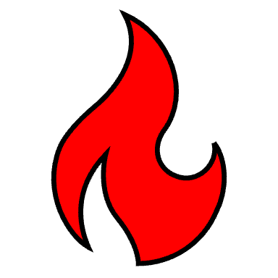
0.0 Escape
HMM-N ☑
< prev
next >
WEBPAGE 19ofX
Hazard Mitigation Options: The 3 Rs and Home Hardening
HMM provides options for balancing flame exposures and structure hardening. Balancing exposures and structure hardening can be done either by:
- reducing exposures or
- hardening the home
Flame Exposures can be reduced using the 3 Rs, namely Reduce, Remove and/or Relocate the fuel source that causes the exposure. Examples include getting a smaller shed, relocate a wood pile, and remove an RV.
It is always better to remove the exposure hazard, by displacing or eliminating the exposure. No exposure means no hazard, whereas the flaming exposure can overwhelm the home hardening, resulting in a structure ignition. Structure ignition can occur if either the exposure is underestimated, or the hardening is not “strong enough.”
Figure xx illustrates a shed hazard and two separate solutions. Figure yy shows all relocation options must be evaluated in the context of the primary and surrounding parcels. This is a critical part of HMM as discussed earlier in this section.
Home hardening should be used only when the 3 Rs options have been evaluated and it's been determined that the 3 Rs cannot be used.
POP-UP 3f NEW WINDOW
Scenario 1
Residence
Scenario 2
Scenario 3
Residence
✓
Residence
!
SSD
✓
SSD
!
Aux. Str.
SSD
Aux. Str.
Aux. Str.
SSD greater than 50 ft
SSD between 25 ft and 50 ft
SSD less than 25 ft
Relocation of Fuels
✓
Low/reduced hazard
!
Hazardous condition
!
Likely ignition condition
Three scenarios with a range of Structure Separation Distances (SSDs) between the primary residence and auxiliary structure >120 ft²:
greater than 50 ft,
between 25 ft and 50 ft, and
under 25 ft.
Structure hardening to increase ignition resistance is illustrated in blue (Scenario 2). In Scenario 2, hardening for flames is directional and is not necessarily required around the entire structure.
Hardening for embers is required in all scenarios.
NIST TN 2205 (HMM), Figure 15.
Assessing Fuels Relocation in the Context of Location not Parcel Boundaries
Scenario 1
While Scenario 1 looks at first glance to be a good option, it is not. Scenario 1 has solved the problem for one house by creating a problem for the neighboring house (Figure yy).
Combining the information in Figures xx and yy, we can now see two solutions to address the shed fire hazard:
Scenario 2 – this outcome requires two sides of the house to be hardened to withstand flames from the shed. This depending on the house construction, may require new siding and new windows.
Scenario 4 (not illustrated) – removal of the shed. This is the less expensive solution and “safer” solution as it does not rely on hardening to prevent structure ignition.
In smaller parcels, it may be difficult to find areas to place fuels that do not impact surrounding homes.
How to Use Setbacks when Relocating a Fuel?
In relocating a fuel, use Structure Separation Distance (SSD) to identify possible locations that will not cause exposure issues to fuels on your property or your neighbors.
A simplified approach, is to use the same SSD between the fuel and you house and also between your fuel and your property line.
Putting this into use:
Using Figure yy, you want SSD 1 to be equal or greater that SSD2.
In the HMM Parcels Checklist (section 5.2.3) Structure Separation distance is referred by the more generic name Fuels Separation Distance (FSD)
Residence
SSD 1
✓
Aux. Str.
!
SSD 2
Neighboring
Residence
NIST TN 2205 (HMM), Figure 15.
✓
Low/reduced hazard
Likely ignition condition
!
!
Fuel relocation must consider neighboring parcels

Slide 22
0.0 Escape
HMM-N ☑
< prev
next >
WEBPAGE 20ofX
4.0 How to Use the NIST HMM Virtual Community
This module is designed to show how a community/neighborhood, a parcel and a house all need to work together to reduce WUI fire losses.
In the NIST Virtual WUI Community there are four different types of neighborhoods. These neighborhoods represent different types of buildings and building densities.
At the neighborhood level, hazards are identified, and solution are provided together with successful best practices.
In each neighborhood type a single house is selected to showcase, at the house level hazards and solutions.
The examples are designed to illustrate hazards. Additional hazards may be present. In order as not to overwhelm the virtual environment, not all hazards are highlighted. To further help make the virtual environment more user friendly, not all possible hazards are shown in all four community types and all four homes.
There are three separate steps to using the NIST Virtual WUI Community:
Pick your neighborhood type
Learn about fire hazards and solutions in your neighborhood type
Example of fire hazards and solutions for a house in the neighborhood
TYPES OF COMMUNITIES:
LOW-DENSITY
MEDIUM-DENSITY
HIGH-DENSITY
HIGH-DENSITY TOWNHOMES PIX OF Community w/ neighborhoods (Patches) identified
TYPES OF HOMES:
TWO-STORY COLONIAL
ONE-STORY RANCH
TOWNHOME
MOBILE HOME
HIGH-DENSITY TOWNHOMES PIX of Four homes
Pick your neighborhood type
Images of four neighborhoods zoom in of one of them
The goal of selecting the neighborhood that most closely resembles yours is to get to the representative spacing between houses. The spacing also known as Structure Separation Distance (SSD) together with the fuels on your and the neighboring parcels have significant impact on how houses will need to be hardened or protected.
The four types of neighborhoods represented are low density single family, moderate density single family, high density modular or mobile home and a town home development.
All neighborhoods have some similarities in fuels that can be present near houses and also in some house construction details like doors and windows. The density between structures and the construction type affect what actions can be taken to prevent fire losses from WUI fires.
Learn about fire hazards and solutions in the neighborhood
Image of Red Dot with Pop up
This is the first interactive parts of the HMM website/tool. Once you select your NIST Virtual WUI Neighborhood type you will be able to navigate around by viewing it from various directions by using the arrows located halfway up the image.
The Virtual Neighborhood has hazards identified in Red and “successes” identified in Green markers. By clicking on the Red, you can learn about the fire hazards or problems and see what solutions may be available to solve the various problems. By clicking on the Green markers, you can learn more about scenarios that help reduce ignitions and reduce or eliminate hazards.
Explore the Virtual Neighborhood from various angles as some of the Red and Green markers are hidden in some of the views.
To make the Virtual Neighborhood easier to navigate not all hazards are marked, however, each type of hazard is marked at least once.
Take the time to learn about the different hazards, solutions and “successes” as see how they relate to your neighborhood.
Once you have familiarized yourself with the hazards, solutions and “successes” you can move into the house level where a lot more detail is provided on the actions that are needed to protect the house from both fire and embers.
Image of “Success” with Pop up
WEBPAGE 20ofX
Continues
↓ ↓ ↓ ↓ ↓

Slide 23
0.0 Escape
HMM-N ☑
< prev
next >
WEBPAGE 20ofX
continued
Example of fire hazards and solutions for a house in the neighborhood
After exploring and learning in your NIST Virtual WUI Neighborhood, the next step is to look in more detail at what needs to be done at the house and attached fuels. The house/parcel/neighborhood are all interconnected so the hazards and “successes” you learned when exploring the neighborhood are still critical. To provide variety and highlight some construction specific features, each neighborhood has a single type of house that is highlighted. You can use Table xx to also get directly to your house type highlighted if your neighborhood type does not match your home. Like in the Virtual WUI Neighborhood, you can click on the Red and Green markers to learn about the problems and solutions as well as the “successes” at and around the house.
Neighborhood and Selected Home Type
Key messages to remember when exploring the Virtual Homes:
You must address with all the ember ignition problem areas on your house
In some cases, you may not have to harden a wall (and windows) by removing, relocating or reducing the fuel source that is causing the exposure. This can potentially save a lot of money.
Do not just push fuels to the edge of your property
Remember that an exposure may come from a neighboring parcel, the same way one of your fuels maybe a problem for your neighbors.
Neighborhood Type | Home Type
Low Density | Single Story Ranch
Moderate Density | Two Story Colonial
High Density | Mobile Home
Town Home | Town Home

Slide 24
0.0 Escape
HMM-N ☑
< prev
next >
WEBPAGE 21ofX
5.0 The NIST Virtual WUI Community
Community, patch, and parcel/house (launch pad?)

Slide 25
0.0 Escape
HMM-N ☑
< prev
next >
6.0
How to Implement HMM in your Neighborhood?
WEBPAGE 22ofX
6.1
How to get started and what you will need
6.2
HMM Implementation Fact Sheet, Checklists and Drawings
6.3
HMM Implementation Limitations
6.4
HMM Implementation Costs
6.5
The Critical Importance of HMM Maintenance
6.0 How to Implement HMM in your Neighborhood?
How to get started and what you will need
How to get started
To apply HMM to your structure/parcel and neighborhood will take time, effort and resources. An HMM Implementation Workflow has been developed to specifically help you with tackling your neighborhood WUI fire hazard mitigation.
What will you need
To successfully implement HMM in your neighborhood you will need:
An understanding of how fire spreads, how homes ignite and how to prepare your home, parcel and surroundings.
Engagement and participation from your neighbors To engage your neighbors, printout and use the HMM Fact Sheet. This will get them acquainted with HMM and directed to this website to learn more about what is HMM and your neighborhood can work together to prepare for WUI fires.
Supply materials and funds HMM activities fall into two different categories:
Parcel level activities – on your parcel or neighboring parcels) and
Activities on your residence. To learn more about how your community may be able an apply for federal funding see section Section 6.0 HMM Resources.
Any necessary permits for specific activities that are required in your jurisdiction. Check local ordinances and HOA regulations as necessary to ensure compliance with local regulations for any activities that may require permitting.
Tools to implement HMM
In addition to the HMM Fact sheet and HMM Implementation workflow, three more tools are provided:
HMM Parcels Checklist – this will help you identify any possible fire exposure hazards on your and on neighboring parcels
HMM Structure Ember Hardening Checklist – this will help you identify all the vulnerabilities on your home
HMM Implementation Drawings – these can be used by contractors to implement specific structure changes.
How to tackle the long list of actions?
Depending on the specifics of your home, parcel and neighborhood it may take very little or a lot to implement HMM in your neighborhood.
While any action you take will “add value” HMM is designed to work as a system and ALL the identified hazards need to be addressed.
To implement HMM work with your neighbors. Implementing HMM at the community level may allow your community to gain access to Federal funding (see Section 6.0 HMM Resources).
How fast do you need to do everything?
While HMM level protection will not be achieved until all the hazards are addressed, it will take time to implement HMM. The key here is to develop a realistic plan to get your neighborhood to fully implement HMM. The faster you can take all the actions, the sooner your will significantly increase the ignition resistance of the homes in your neighborhood.

Slide 26
0.0 Escape
HMM-N ☑
< prev
next >
6.0
How to Implement HMM in your Neighborhood?
WEBPAGE 23ofX
6.1
How to get started and what you will need
6.2
HMM Implementation Fact Sheet, Checklists and Drawings
6.3
HMM Implementation Limitations
6.4
HMM Implementation Costs
6.5
The Critical Importance of HMM Maintenance
6.2 HMM Implementation Fact Sheet, Checklists and Drawings
6.2.1
HMM Fact Sheet
6.2.2
HMM Implementation Workflow
6.2.3
HMM Parcels Checklist
6.2.4
HMM Structure Ember Hardening Checklist
6.2.5
HMM Implementation Drawings – For Contractors
6.2.1 HMM Fact Sheet
Foundations of HMM
Based on Exposures – not parcel based
Addresses both fire and ember exposures
Comprehensive not optional (see 1.1 Why Good Enough does not work in WUI Fires)
Acknowledges the impacts of Fuels Agglomeration (fuels near each other)
Acknowledges the negative impacts of placing fuels at the edge of the property
Additional Benefits
Designed to limit retrofit expenses
Provides implementation solutions that leverage structure, parcel and neighborhood specifics
Illustrates the effects of partial hardening on community losses as a function of housing density
The WUI Fire Problem
How WUI fire spreads?
Fire and Ember exposures
Why Homes Burn?
Imbalance
Lack of tracking and addressing hazards
What is needed?
What is HMM and why is different?
HMM Resources
HMM-AHJ, HMM-N, Drawings, checklists and implementation workflow, grants for mitigation.
Who can use HMM?
Neighbors and AHJs
QR Codes for HMM-AHJ and HMM-N
Residence
Scenario 3
How HMM Compares to other mitigation approaches? (this table is in Section 3, slide 15)
!
HMM Features/Benefits | Other Mitigation Approaches
HMM is exposure based Why? Fire does not care about ownership. This is one of the fundamental differences between HMM and other approaches. | Almost all other approaches are Parcel Based Why? Historical context, mitigation has been historically addressed at the parcel level, as this is easier to convey and regulate
HMM addresses exposures from both fire and embers. Why? Because all exposures that can result in structure ignition must be addressed. | Do not address all exposures, specifically the ones that are hard to mitigate or belong to someone else on a neighboring property.
HMM requires hardening for all ember vulnerabilities (weak spots) Why? Because when your house get bombarded by one million embers, they will find that weak spot. Fire is like water going down hill. IT will find the path of least resistance and get your house ignited. | Make ember hardening voluntary or partial, or provide tiered hardening systems
HMM acknowledges that certain exposures cannot be mitigated and focuses on ignition prevention in these situations Why? Acknowledging the limitations of hardening can save retrofit funds and point to the necessary steps to prevent structure ignitions | Does not address impacts of moderate and high-density construction
HMM acknowledges the relationships between partial hardening and community structure losses Why? HMM points to the “very high standards” that have to be maintained to prevent high density communities from suffering extreme losses. | Do not address the impacts of partial mitigations on community losses
SSD
Aux. Str.
SSD less than 25 ft
Residence
Scenario 2
✓
SSD
!
Aux. Str.
SSD between 25 ft and 50 ft
Residence
Scenario 1
SSD
✓
Aux. Str.
SSD greater than 50 ft
✓
Low/reduced hazard
Hazardous condition
Likely ignition condition
!
!

Slide 27
0.0 Escape
HMM-N ☑
< prev
next >
6.0
How to Implement HMM in your Neighborhood?
WEBPAGE 24ofX
6.1
How to get started and what you will need
6.2
HMM Implementation Fact Sheet, Checklists and Drawings
6.3
HMM Implementation Limitations
6.4
HMM Implementation Costs
6.5
The Critical Importance of HMM Maintenance
6.2 HMM Implementation Fact Sheet, Checklists and Drawings
6.2.1
HMM Fact Sheet
6.2.2
HMM Implementation Workflow
6.2.3
HMM Parcels Checklist
6.2.4
HMM Structure Ember Hardening Checklist
6.2.5
HMM Implementation Drawings – For Contractors
6.2.1 HMM Implementation Workflow
Two parallel tracks:
Assess and document flame exposures (Figure xx)
Work on addressing all flame exposures using 3 Rs and, when necessary, home hardening
Use 4 sectors, A, B, C, D workflow
Identify and document all fuels that pose a flame exposure hazard using HMM Parcels Checklist
Work with your neighbors to reduce parcel to parcel exposures and reduce home hardening costs.
Assess and document embers vulnerabilities (Figure - 4 sides of house)
Work on hardening all ember vulnerabilities, drawings are provided to help you or your contractor make the necessary changes.

Slide 28
0.0 Escape
HMM-N ☑
< prev
next >
6.0
How to Implement HMM in your Neighborhood?
WEBPAGE 25ofX
6.1
How to get started and what you will need
6.2
HMM Implementation Fact Sheet, Checklists and Drawings
6.3
HMM Implementation Limitations
6.4
HMM Implementation Costs
6.5
The Critical Importance of HMM Maintenance
6.2 HMM Implementation Fact Sheet, Checklists and Drawings
6.2.1
HMM Fact Sheet
6.2.2
HMM Implementation Workflow
6.2.3
HMM Parcels Checklist
6.2.4
HMM Structure Ember Hardening Checklist
6.2.5
HMM Implementation Drawings – For Contractors
HMM Structure Ember Hardening Checklist
Note on Ember Hardening:
HMM points to a number of ember vulnerabilities that are typically found on homes. Some homes may have fewer ember vulnerabilities, while others have even more than those listed in HMM.
All home vulnerabilities that are vulnerable to ignition from embers need to be addressed, even if they are not explicitly listed in HMM.
Examples of home ignition vulnerabilities that are not explicitly listed in HMM include:
flower boxes under windows,
ornamental decorations like bales of hay near the front door,
discarded vegetation on the ground around a house, like a Christmas tree, leaf litter, or other detritus,
and any other fuels that can be easily ignited by an ember.
Picture of ignition at main entry with fall decorations, structure defended
A structure that was ignited by combustible fall decorations near the front door. Structure was successfully defended and saved.
These decorations are an example of a vulnerability (problem) to ignition from embers that is not explicitly listed in HMM.

Slide 29
0.0 Escape
HMM-N ☑
< prev
next >
6.0
How to Implement HMM in your Neighborhood?
WEBPAGE 26ofX
6.1
How to get started and what you will need
6.2
HMM Implementation Fact Sheet, Checklists and Drawings
6.3
HMM Implementation Limitations
6.4
HMM Implementation Costs
6.5
The Critical Importance of HMM Maintenance
6.2 HMM Implementation Fact Sheet, Checklists and Drawings
6.2.1
HMM Fact Sheet
6.2.2
HMM Implementation Workflow
6.2.3
HMM Parcels Checklist
6.2.4
HMM Structure Ember Hardening Checklist
6.2.5
HMM Implementation Drawings – For Contractors
HMM Implementation Drawings – For Contractors
Take from HMM-AHJ

Slide 30
0.0 Escape
HMM-N ☑
< prev
next >
6.0
How to Implement HMM in your Neighborhood?
WEBPAGE 27ofX
6.1
How to get started and what you will need
6.2
HMM Implementation Fact Sheet, Checklists and Drawings
6.3
HMM Implementation Limitations
6.4
HMM Implementation Costs
6.5
The Critical Importance of HMM Maintenance
There are several reasons why HMM may not be successfully implemented across a neighborhood including:
Voluntary participation by hesitant neighbors and no enforcement authority unless HMM is adopted by a governing body such as HOA, Town Council, or Fire Safe Council.
Unavailability of funds.
External uncontrolled exposures such as next to an untreated forest or other high energy release fuel close to the community. Very high exposures can result in local structures ignitions, which based on community density can have significant impact on the community.
Partly implementing HMM in Moderate and High-density construction can result in significant losses. A non-HMM home that ignites in a high-density neighborhood can “burn down” a large fraction of the community because it is very difficult to stop fire spread in that environment where there is any type of wind around ~20 mph or above. This is why a neighborhood approach is selected here instead of an individual home/parcel.
HMM assumes a certain minimum ignition resistance to embers for the structure roof and siding. IF the structure has siding or roofing that is old and readily ignitable by embers, structure hardening will be necessary (new roof and all new siding).
New residents in the neighborhood. This can occur when an HMM compliant home is sold and the new residents are not aware of the neighborhood HMM implementation.
Implementation must be followed by maintenance as discussed in Section 5.5.
HOA or other jurisdiction prevent certain aspects of HMM implementation, this can occur for aesthetic, environmental, ecological or other reasons.
HMM is only selectively/partly implemented across a property or a neighborhood/community.
Neighbors that do not want to engage.

Slide 31
0.0 Escape
HMM-N ☑
< prev
next >
6.0
How to Implement HMM in your Neighborhood?
WEBPAGE 28ofX
6.1
How to get started and what you will need
6.2
HMM Implementation Fact Sheet, Checklists and Drawings
6.3
HMM Implementation Limitations
6.4
HMM Implementation Costs
6.5
The Critical Importance of HMM Maintenance
How much will it cost?
The cost of implementing HMM in your neighborhood will be influenced by three main components:
The housing density in your neighborhood.
Why? If homes are very close together, less than 25 ft, there will be little hardening needed to address structure to structure exposures as discussed in section 2.0 (POP-UP 5). Similarly, if homes are further than 50 ft apart no hardening will be needed to address structure to structure exposures. Home hardening is one of the significant costs of implementing HMM.
Construction and home particulars.
Why? Older homes may require more updates compared to homes that have been built to some national or state WUI Building Code. Some of the work will require specialized expertise and may need to be done by a licensed contractor. The size and complexity of the home will also play a significant role here.
Amount and types of parcel level fuels on properties (yours and your neighbors)
Why? More fuels will require more mitigation, whether by using the 3 Rs (when necessary) or using preferential home hardening as discussed in Section 2 (POP-UP 6)
An implementation cost estimation study conducted by NIST can be found in Section 6.5 (isn’t’ this referring to this section here?)

Slide 32
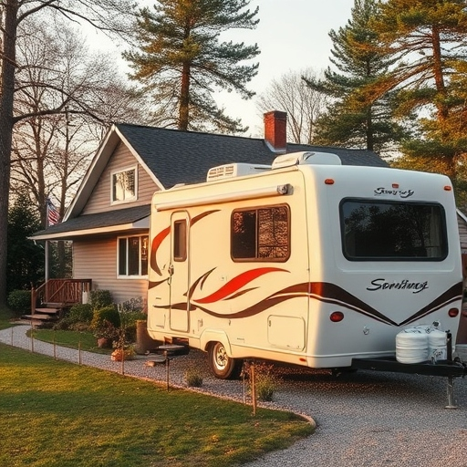
0.0 Escape
HMM-N ☑
< prev
next >
6.0
How to Implement HMM in your Neighborhood?
WEBPAGE 29ofX
6.1
How to get started and what you will need
6.2
HMM Implementation Fact Sheet, Checklists and Drawings
6.3
HMM Implementation Limitations
6.4
HMM Implementation Costs
6.5
The Critical Importance of HMM Maintenance
For HMM to work effectively across a neighborhood or community it is critical that its is maintained. The following should be practiced by all neighbors/community members that have participated in implementing HMM:
Prevent fuels displacement without an HMM assessment
Prevent adding new fuels without an HMM assessment
Apply HMM to all structure additions
Avoid even short-term fuel additions that can compromise the HMM integrity of the neighborhood, such as parking an RV in the driveway next to the house a few days before going on a trip.

Slide 33
0.0 Escape
HMM-N ☑
< prev
next >
WEBPAGE 30ofX
7.0 HMM Resources
All must be done, do not try to down select. Resources and time will drive the progress.
7.1 WUI and HMM Glossary
7.2 HMM for AHJs Web-based Tool
7.3 HMM report and Presentations
7.4 Community Application for Federal Funding
7.5 HMM Cost Estimates
7.6 HMM Implementation Q & A
7.7 Serious Game
7.8 Contacts Info
GLOSSARY TERM | DEFINITION
???? | Homeowner Association (HOA), Town Council, or Fire Safe Council: examples of organizations that may promote, support the implementation, or require the use of HMM.
Attached Fuels
Auxiliary Fuels
CODE-PLUS
Convection
Defensive action
Directional hardening | localized hardening for flame exposures. Hardening is only done on the side or sides facing the exposure.
Ember
FSD
Fuels
Fuels Corridors
Hardened or protected home | a home that can withstand the expected fire and ember exposures. An HMM Hardened Home is a stand alone home.
Hardening for embers
Hardening for flames
Heat fluxes
HMM | Hazard Mitigation Methodology
Home hardening
Ladder Fuel
NIST Virtual WUI Community
NIST Virtual WUI Neighborhood
Parcel/lot
Primary Parcel | the parcel or lot the house been assessed with HMM is on.
Radiation
Regulated fuel
SSD | Structure Separation Distance
Stand-Alone home | a structure that can survive a WUI fire without being defended by a fire fighter or resident
Unregulated fuel
Untreated forest | a forest or other wildland fuel that has not received any fuel treatment to reduce fire exposures in this case to an adjacent community
WUI | Wildland Urban Interface
WUI Fire | Fire that burns in a WUI community
HMM for AHJs Web-based Tool
Short description and link
HMM REPORT AND PRESENTATIONS
NIST WUI Fire Days 2023 – description, links
NIST WUI Fire Days 2022 – description, links
Presentation 3
Presentation 4
s
WEBPAGE 28ofX
Continued
↓ ↓ ↓ ↓ ↓

Slide 34
0.0 Escape
HMM-N ☑
< prev
next >
WEBPAGE 30ofX
CONTINUED
Community Application for Funding
Short writeup and Link to FEMA GRANTS. Note that Grants must go through local jurisdiction.
Pre-Disaster Mitigation (PDM) Grant Program | FEMA.gov
X
Y
Z
HMM Cost Estimates
Short write up from Stan
HMM Implementation Q&A
Q: Can NIST help me implement HMM?
A: The goal of this website is to make HMM available to the public and provide tools (in the form of checklists) to help residents and communities implement HMM. At this time, NIST does not offer over the phone support for HMM.
Q: Does NIST recommend special products for hardening?
A: NIST does not endorse or recommend any specific products for home hardening.
Q: Where can I get questions answered on HMM?
A: There is currently no HMM-Hot Line to get questions answered, however, you can use the online portal to leave a question for one of our HMM Specialists.
Q: Where can I or my community look for funds to implement HMM?
A: Your community can look at applying for federal funds, see link provided in Section 7.4
Community Application for Federal Funding
Q: I have a 5-acre plot. Should I still use HMM?
A: Yes, you should still use HMM. Even if your house and immediate surroundings do not directly affect your neighbors, using HMM will ensure that your house is protected from both ember and flame exposures.
HMM: A Serious Game
Short write up from Rino
HMM Contacts at the National Institute of Standards and Technology
Christopher Brown | HMM Developer | 301-975-5852 | Christopher.Brown@NIST.gov
Alexander Maranghides | HMM Developer | 202-567-1634 | Alexander.Maranghides@NIST.gov
Eric D. Link | HMM Developer | 301-975-6814 | Eric.Link@NIST.gov
Priya Lavappa | HMM Website Administrator | 301-975-4522 | Priya.Lavappa@NIST.gov
Lucy Fox | HMM Website ??? | 301-975-6860 | Lucy.Fox@NIST.gov

